Slide 2

DESIGN A SERVING
MOBILE ROBOT FOR RESTAURANT
Name: Tran Minh Duc – 20181875
Tran Tuan Minh – 20181906
Ly Duc Trung – 20181930
Supervisor: Le Minh Thuy

Slide 3
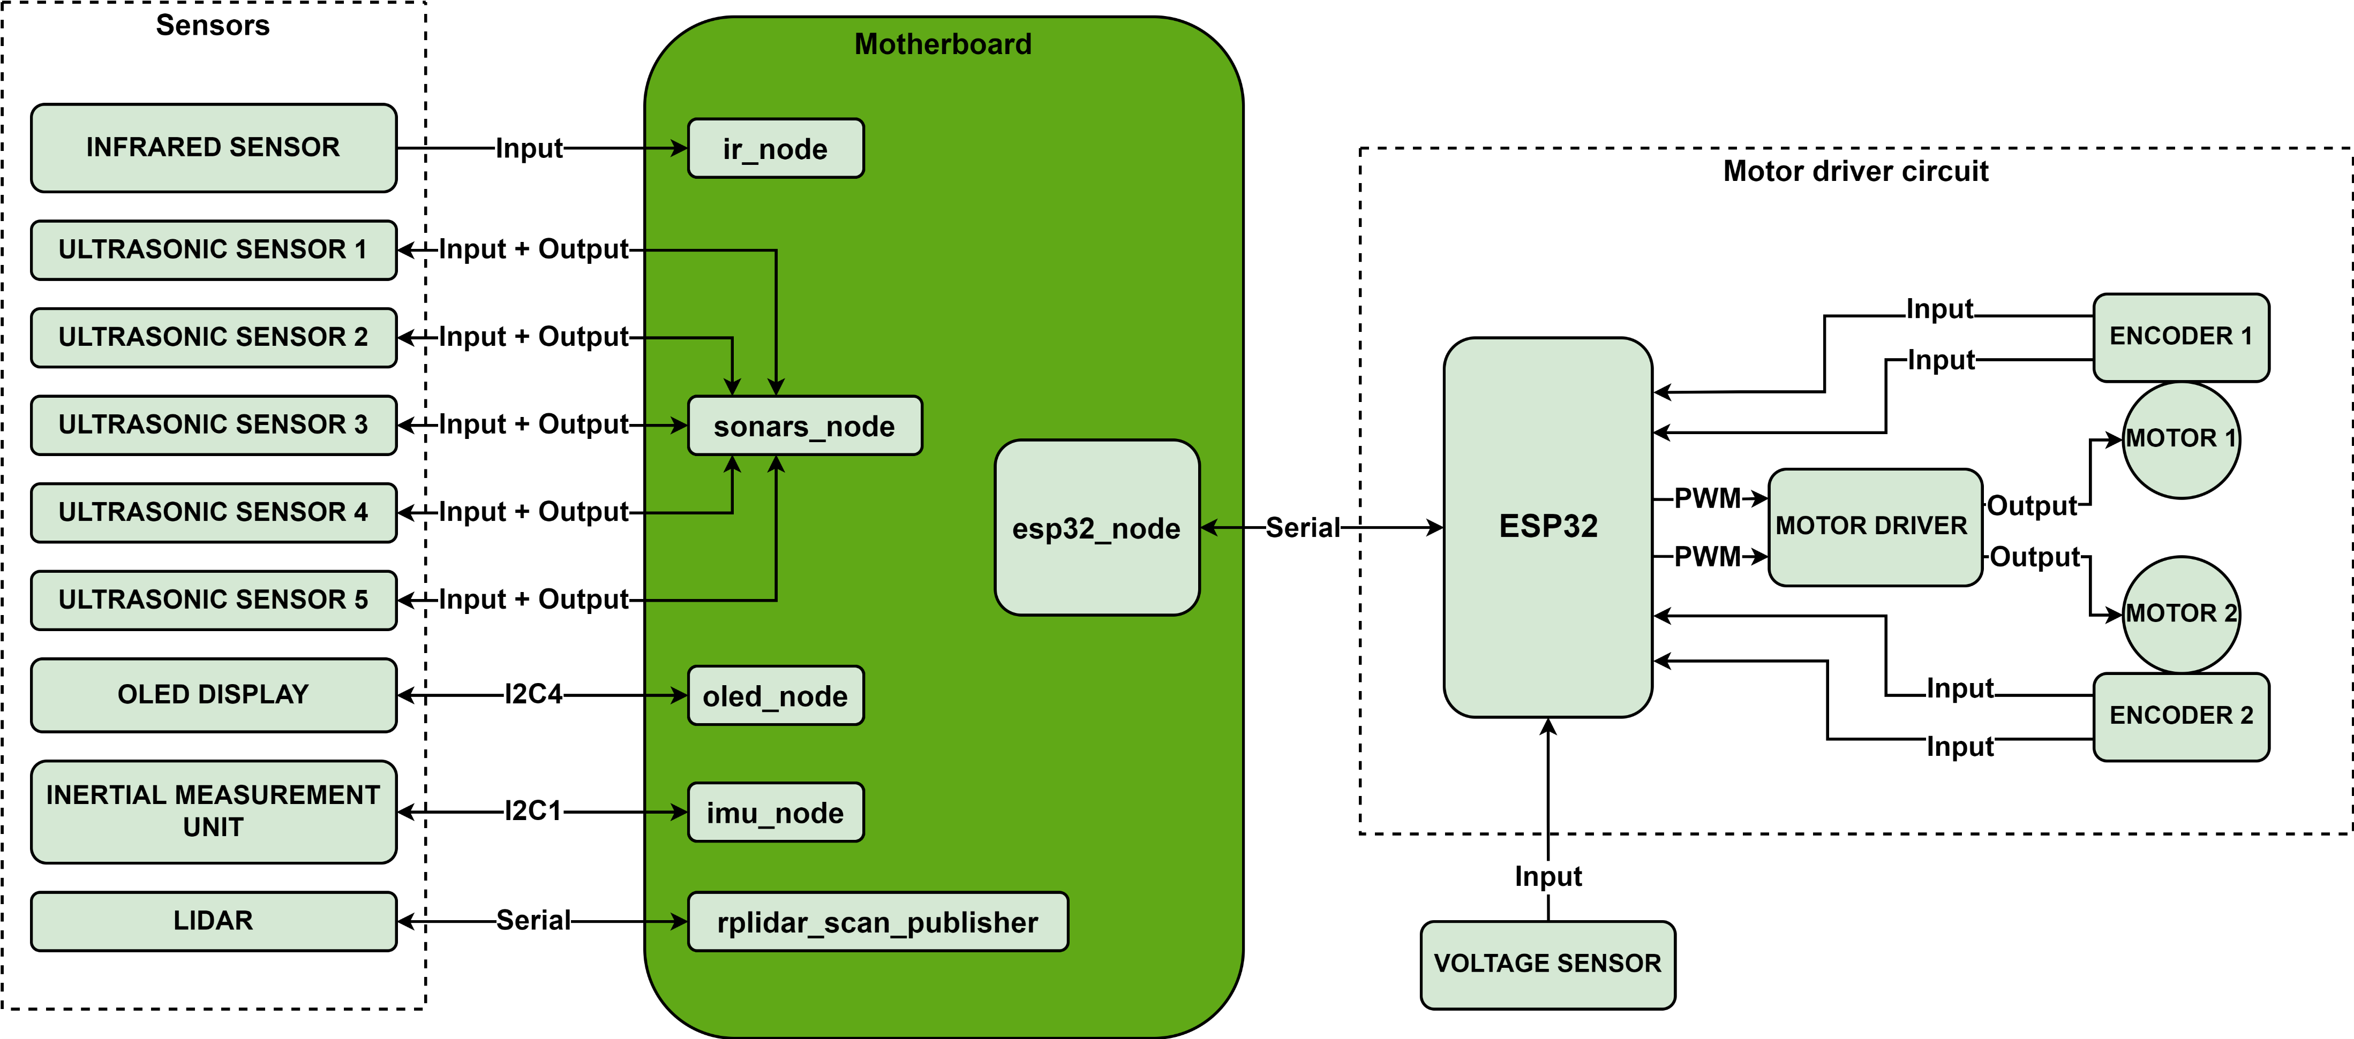
x. FIRMWARE ARCHITECTURE
Fig. 1.1 Firmware architecture

Slide 4
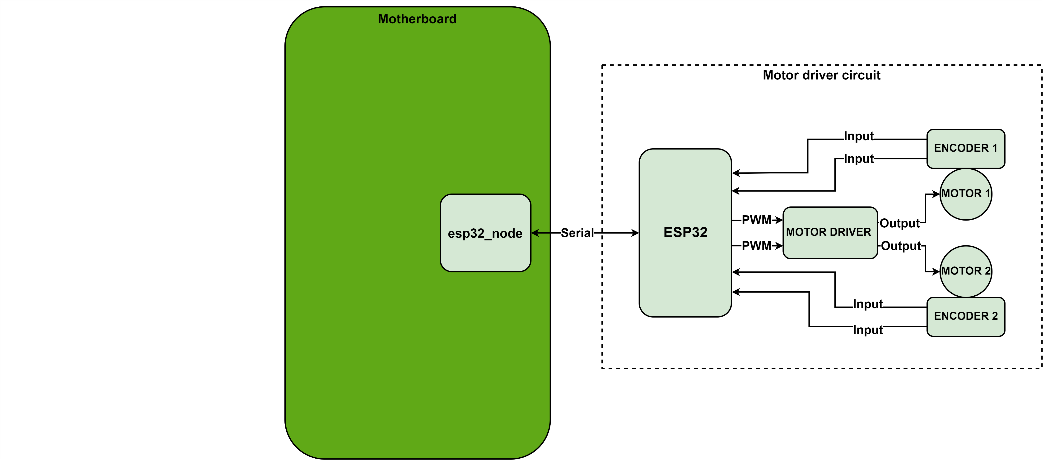
x. MOTOR DRIVER CIRCUIT
Fig. 1.1 Motor driver circuit

Slide 5
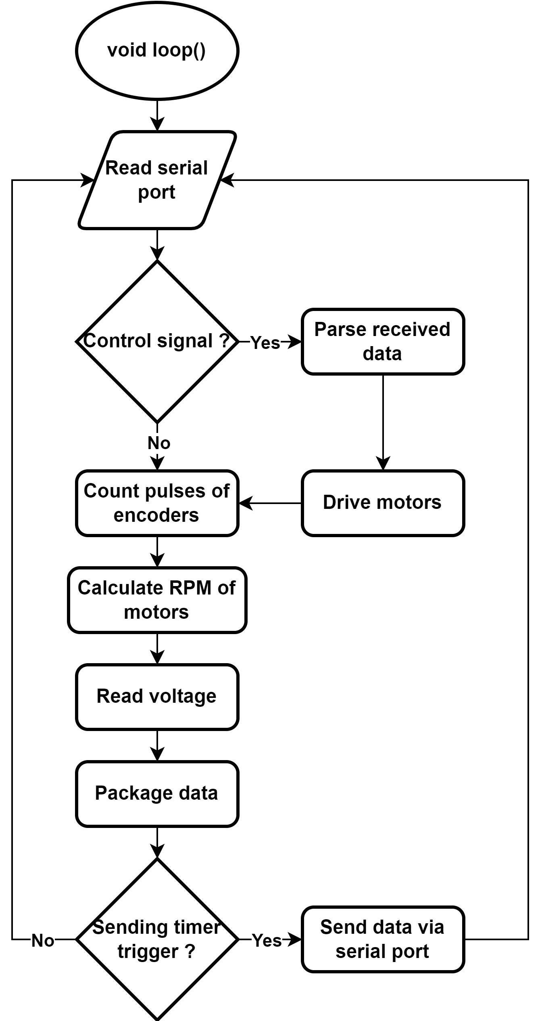
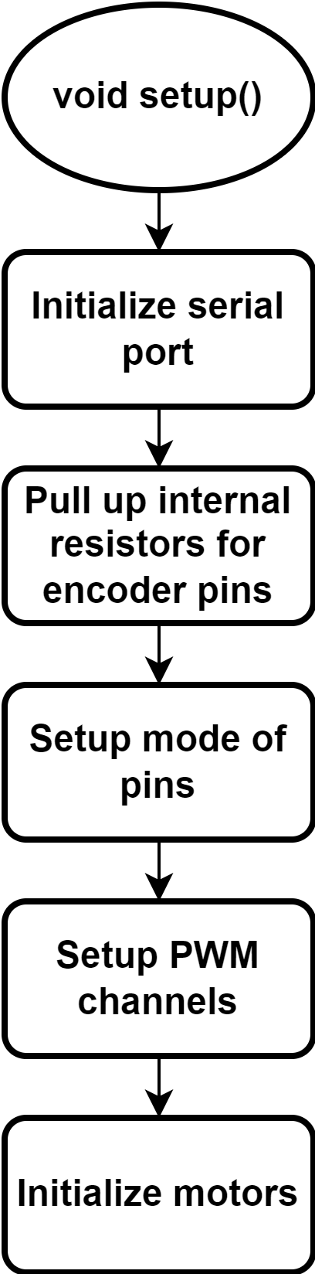
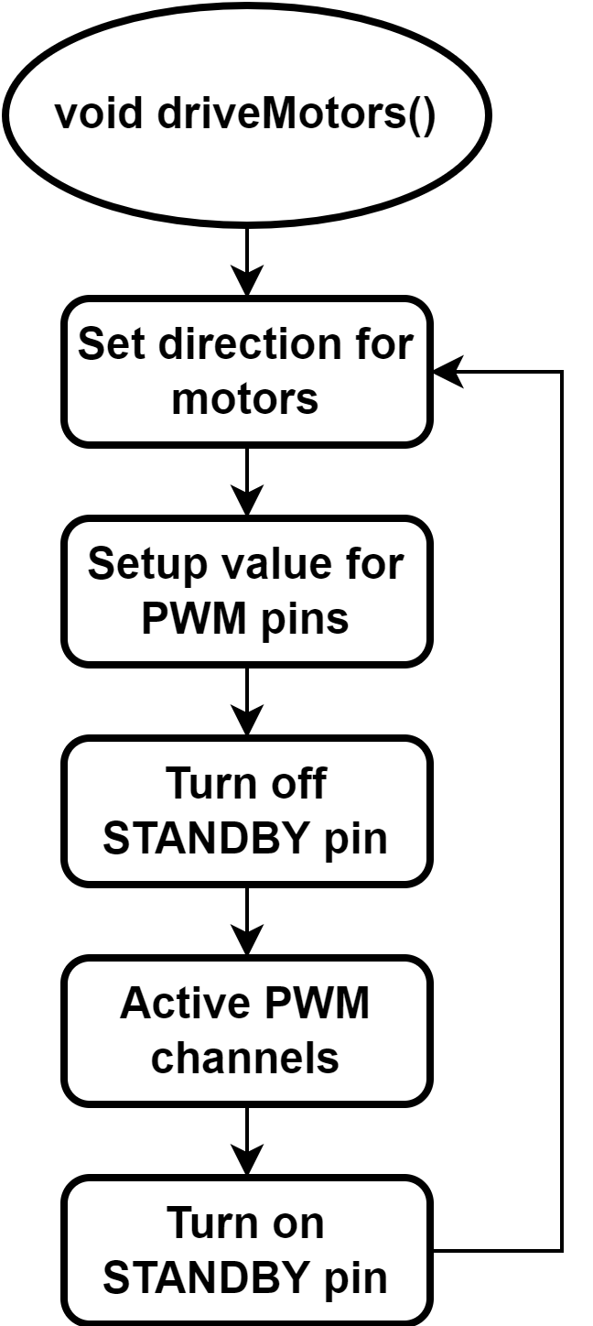
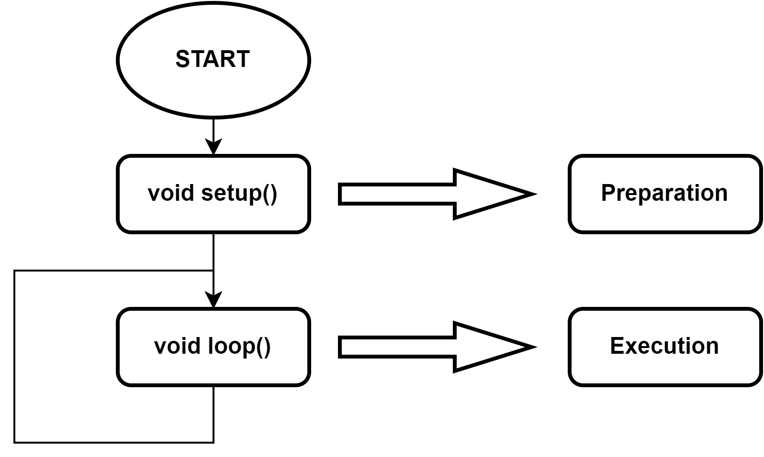
x. MOTOR DRIVER CIRCUIT – ESP32 MCU
Fig. 1.1 Motor driver circuit
Fig. 1.1 Motor driver circuit
Fig. 1.1 Motor driver circuit
Fig. 1.1 Motor driver circuit

Slide 6
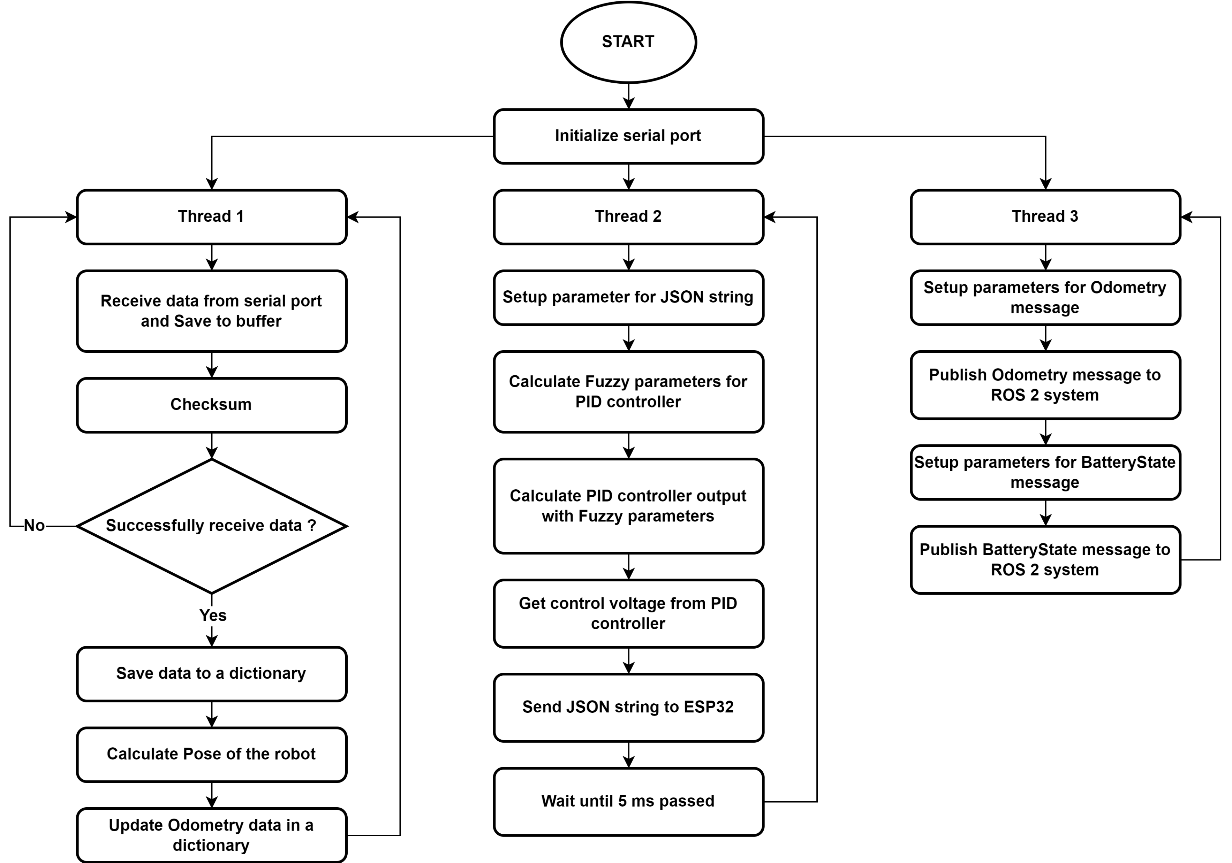
x. MOTOR DRIVER CIRCUIT – RASPBERRY PI 4
Fig. 1.1 Motor driver circuit

Slide 7
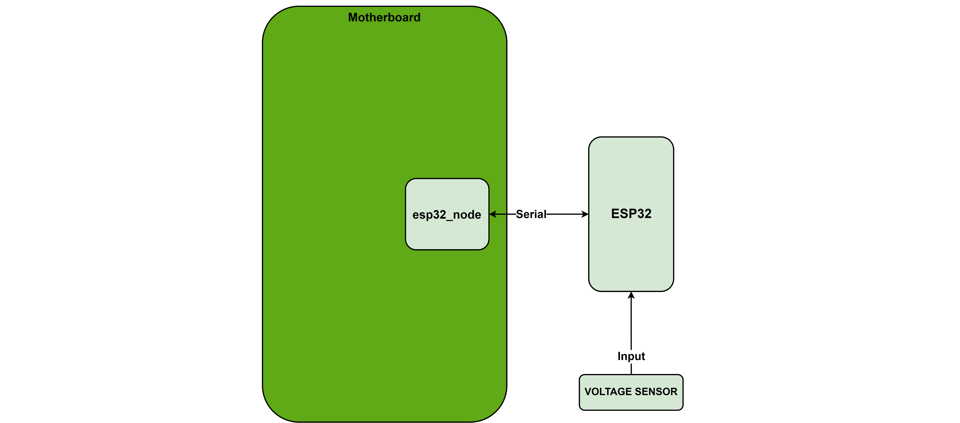
x. VOLTAGE SENSOR
Fig. 1.1 Firmware architecture

Slide 8
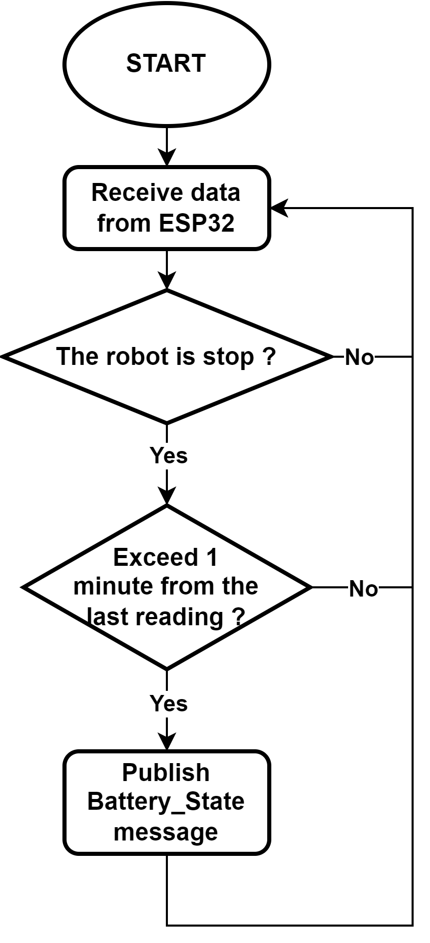
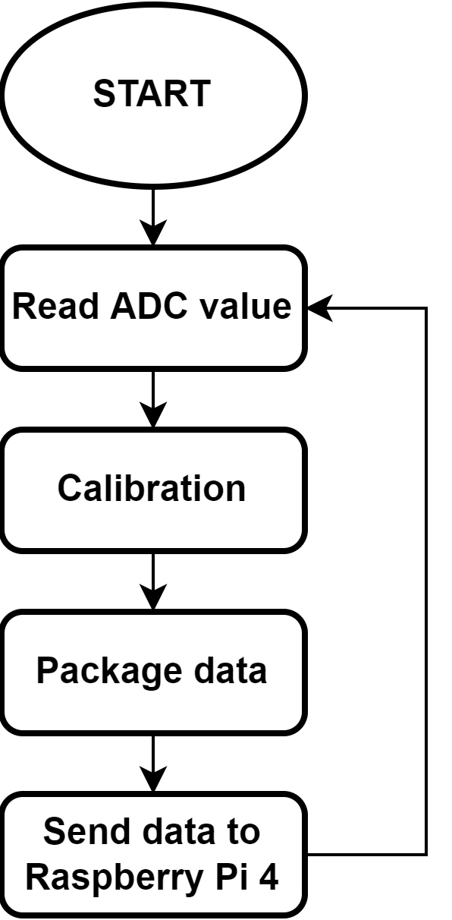

x. VOLTAGE SENSOR
$$V_{real}=V_{ref}−\frac{V_{ref}−V_{read}}{1.668}∙α+ΔV$$
Eq. 1.1 ESP32 microcontroller
Battery voltage | Mainboard voltage | ADC pin voltage | Read voltage | Rate of decrease
12.60 | 12.28 | 3.073 | 3.073 | -
12.58 | 12.27 | 3.072 | 3.071 | 2.000
12.48 | 12.2 | 3.055 | 3.044 | 1.611
12.46 | 12.19 | 3.053 | 3.039 | 1.700
12.43 | 12.13 | 3.039 | 3.022 | 1.500
12.41 | 12.14 | 3.042 | 3.020 | 1.710
12.36 | 12.09 | 3.030 | 3.003 | 1.628
12.31 | 12.04 | 3.016 | 2.979 | 1.649
12.30 | 12.00 | 3.003 | 2.960 | 1.614
12.24 | 11.96 | 2.997 | 2.945 | 1.684
12.19 | 11.91 | 2.983 | 2.924 | 1.656
12.18 | 11.91 | 2.983 | 2.923 | 1.667
12.13 | 11.86 | 2.97 | 2.902 | 1.660
12.12 | 11.82 | 2.961 | 2.890 | 1.634
12.10 | 11.80 | 2.956 | 2.879 | 1.658
12.08 | 11.78 | 2.951 | 2.872 | 1.648
12.05 | 11.75 | 2.944 | 2.858 | 1.667
Fig. 1.1 ESP32 microcontroller
Fig. 1.1 ESP32 microcontroller
Fig. 1.1 ESP32 microcontroller

Slide 9

x. ULTRASONIC SENSORS

Slide 10
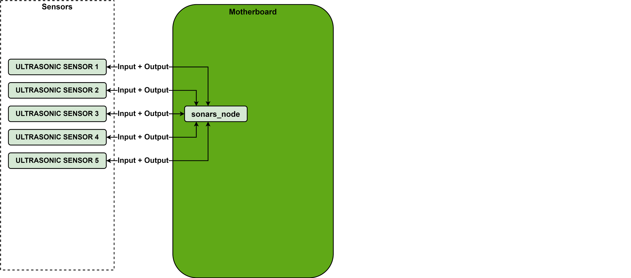
x. ULTRASONIC SENSORS

Slide 11
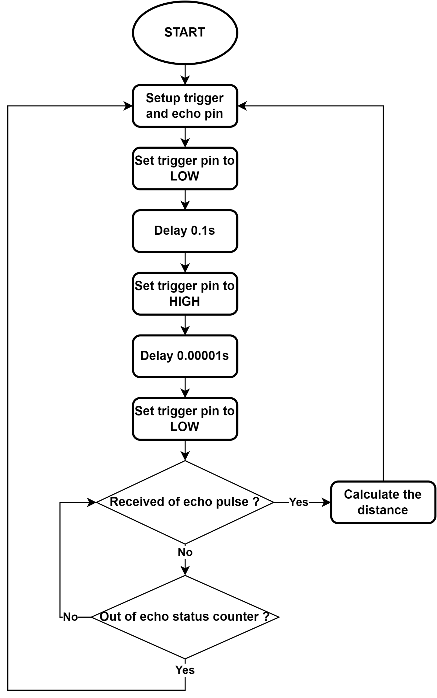
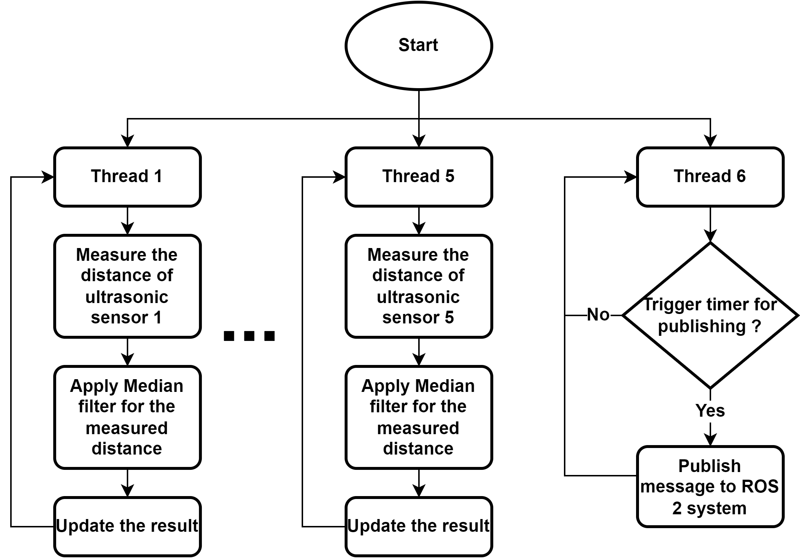
x. ULTRASONIC SENSORS

Slide 12
x. I2C BUSES – PROBLEM AND SOLUTION

Slide 13
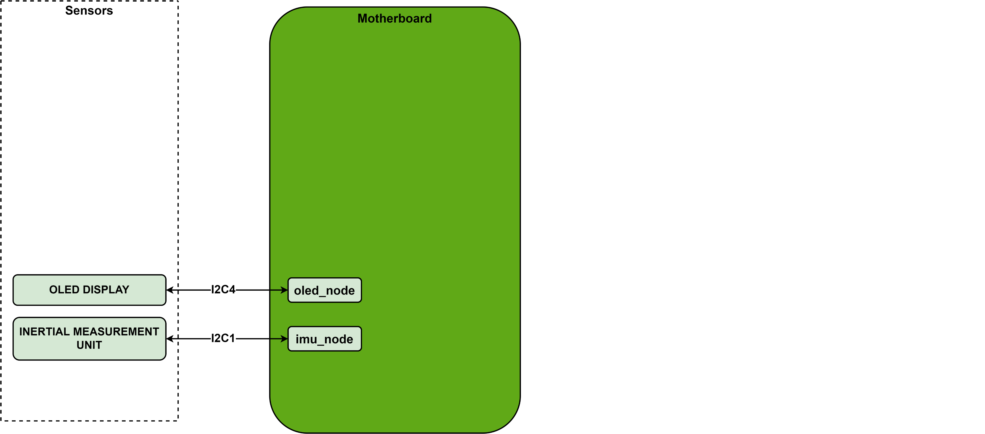
x. I2C BUSES – PROBLEM AND SOLUTION

Slide 14
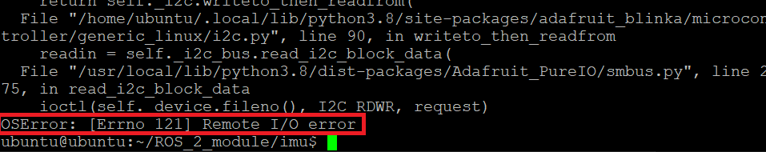
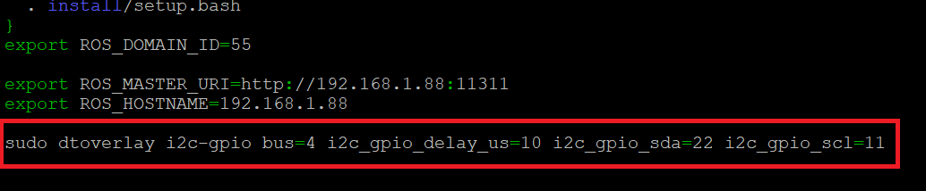
x. I2C BUSES – PROBLEM AND SOLUTION
Problem of I2C buses
Solution of I2C buses

Slide 15
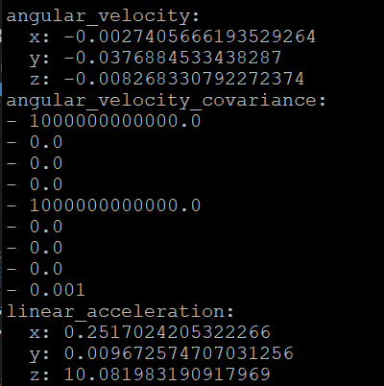
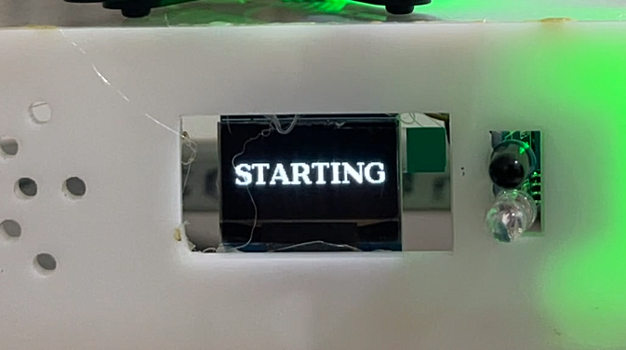
x. I2C BUSES FIXED RESULT
OLED display operates normally
IMU MPU-6050 operates normally

Slide 16
x. OLED DISLPAY

Slide 17
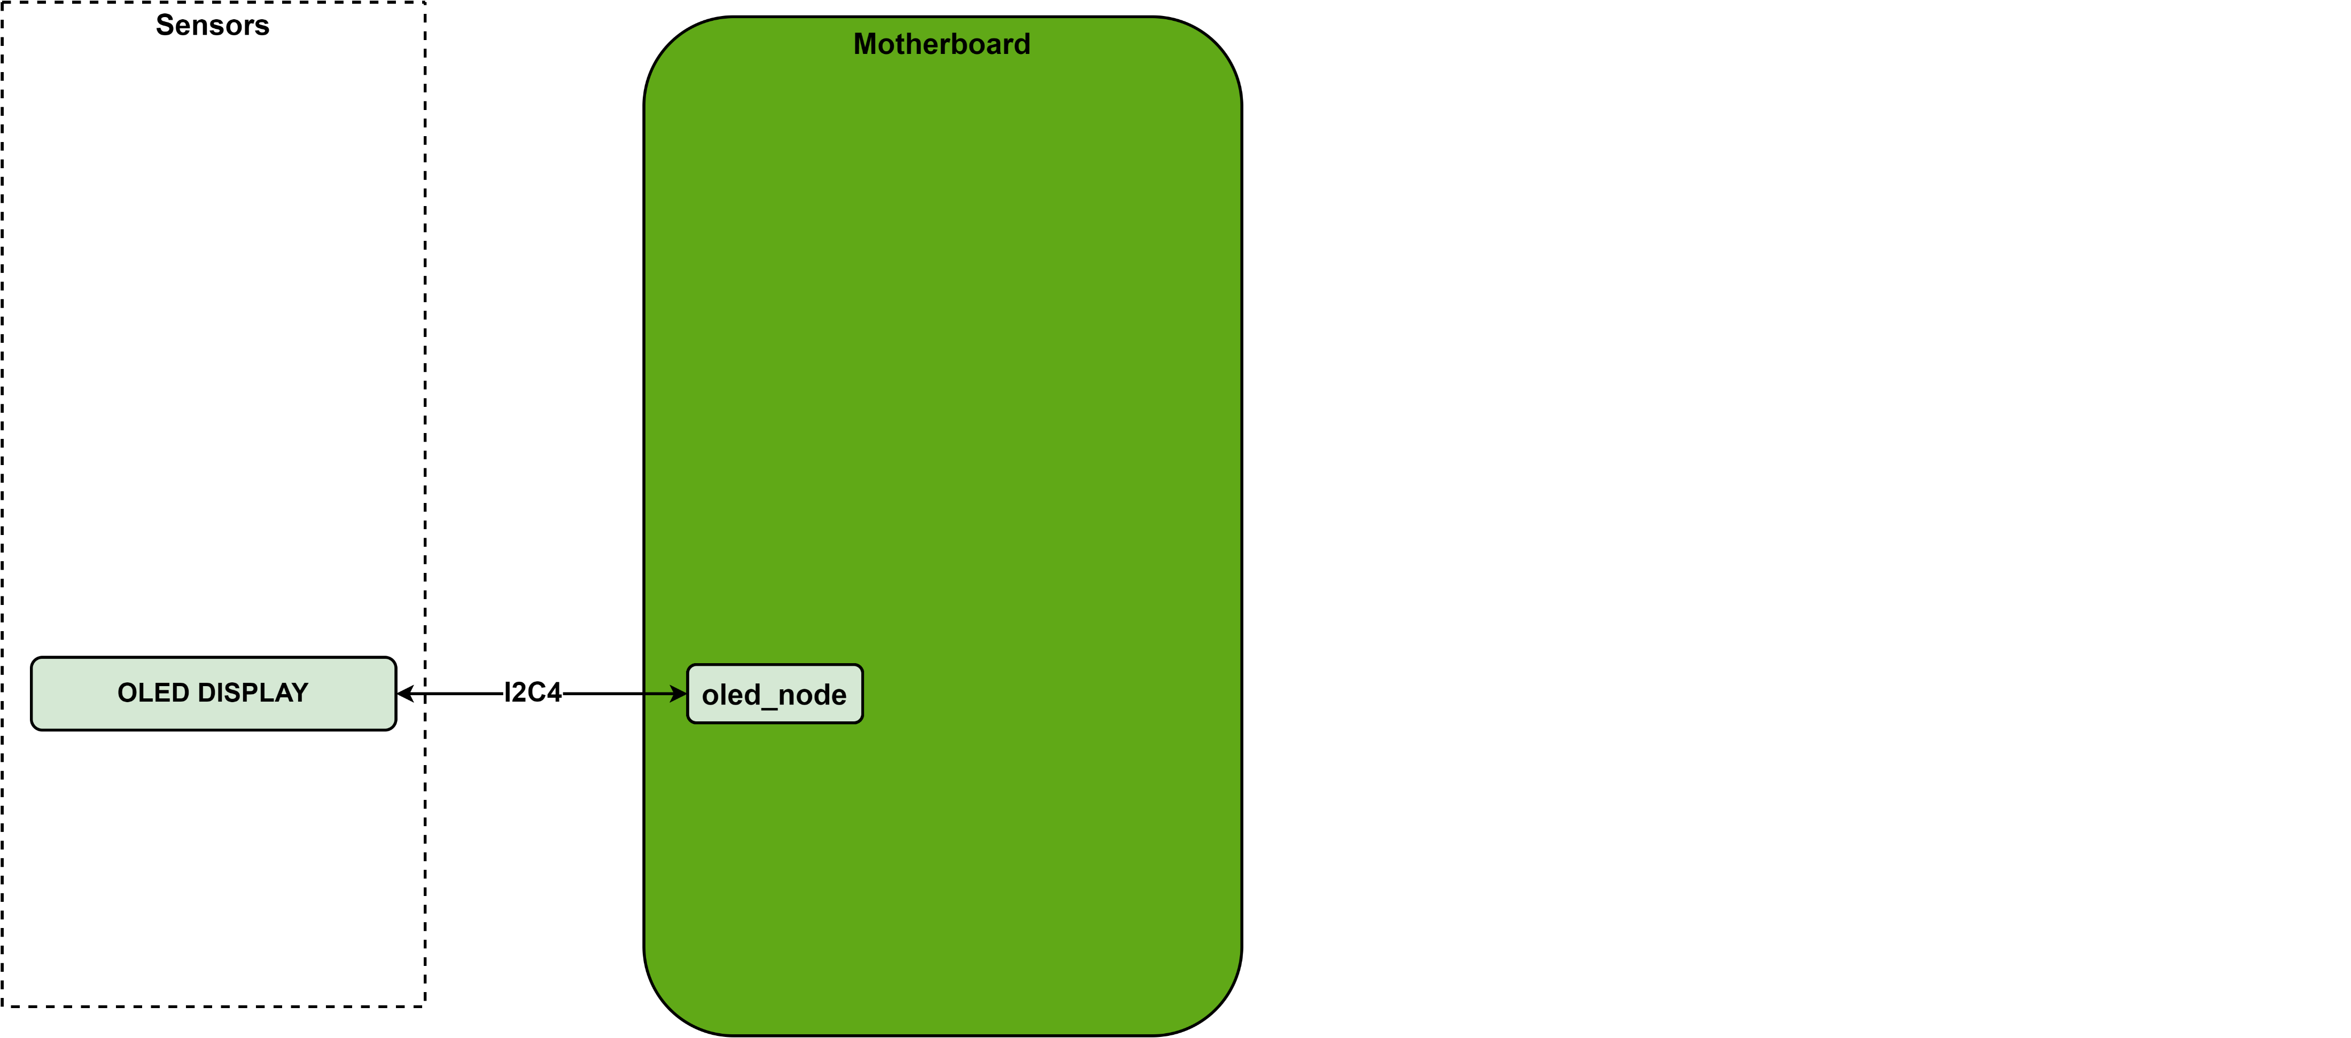
x. OLED DISLPAY

Slide 18
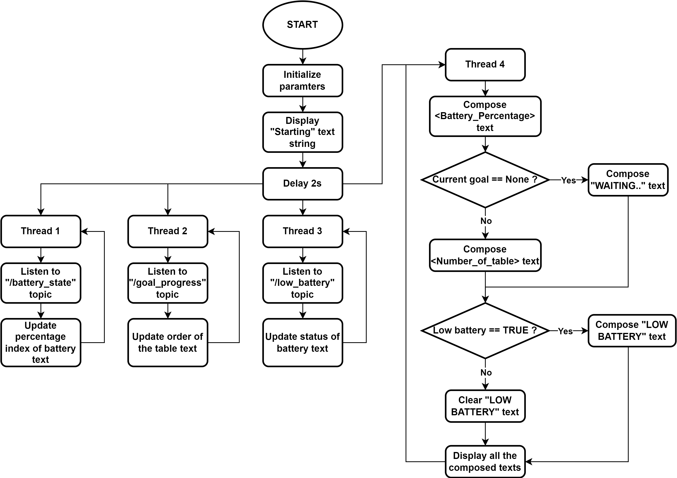
x. OLED DISLPAY

Slide 19
x. INERTIAL MEASUREMENT UNIT SENSOR

Slide 20
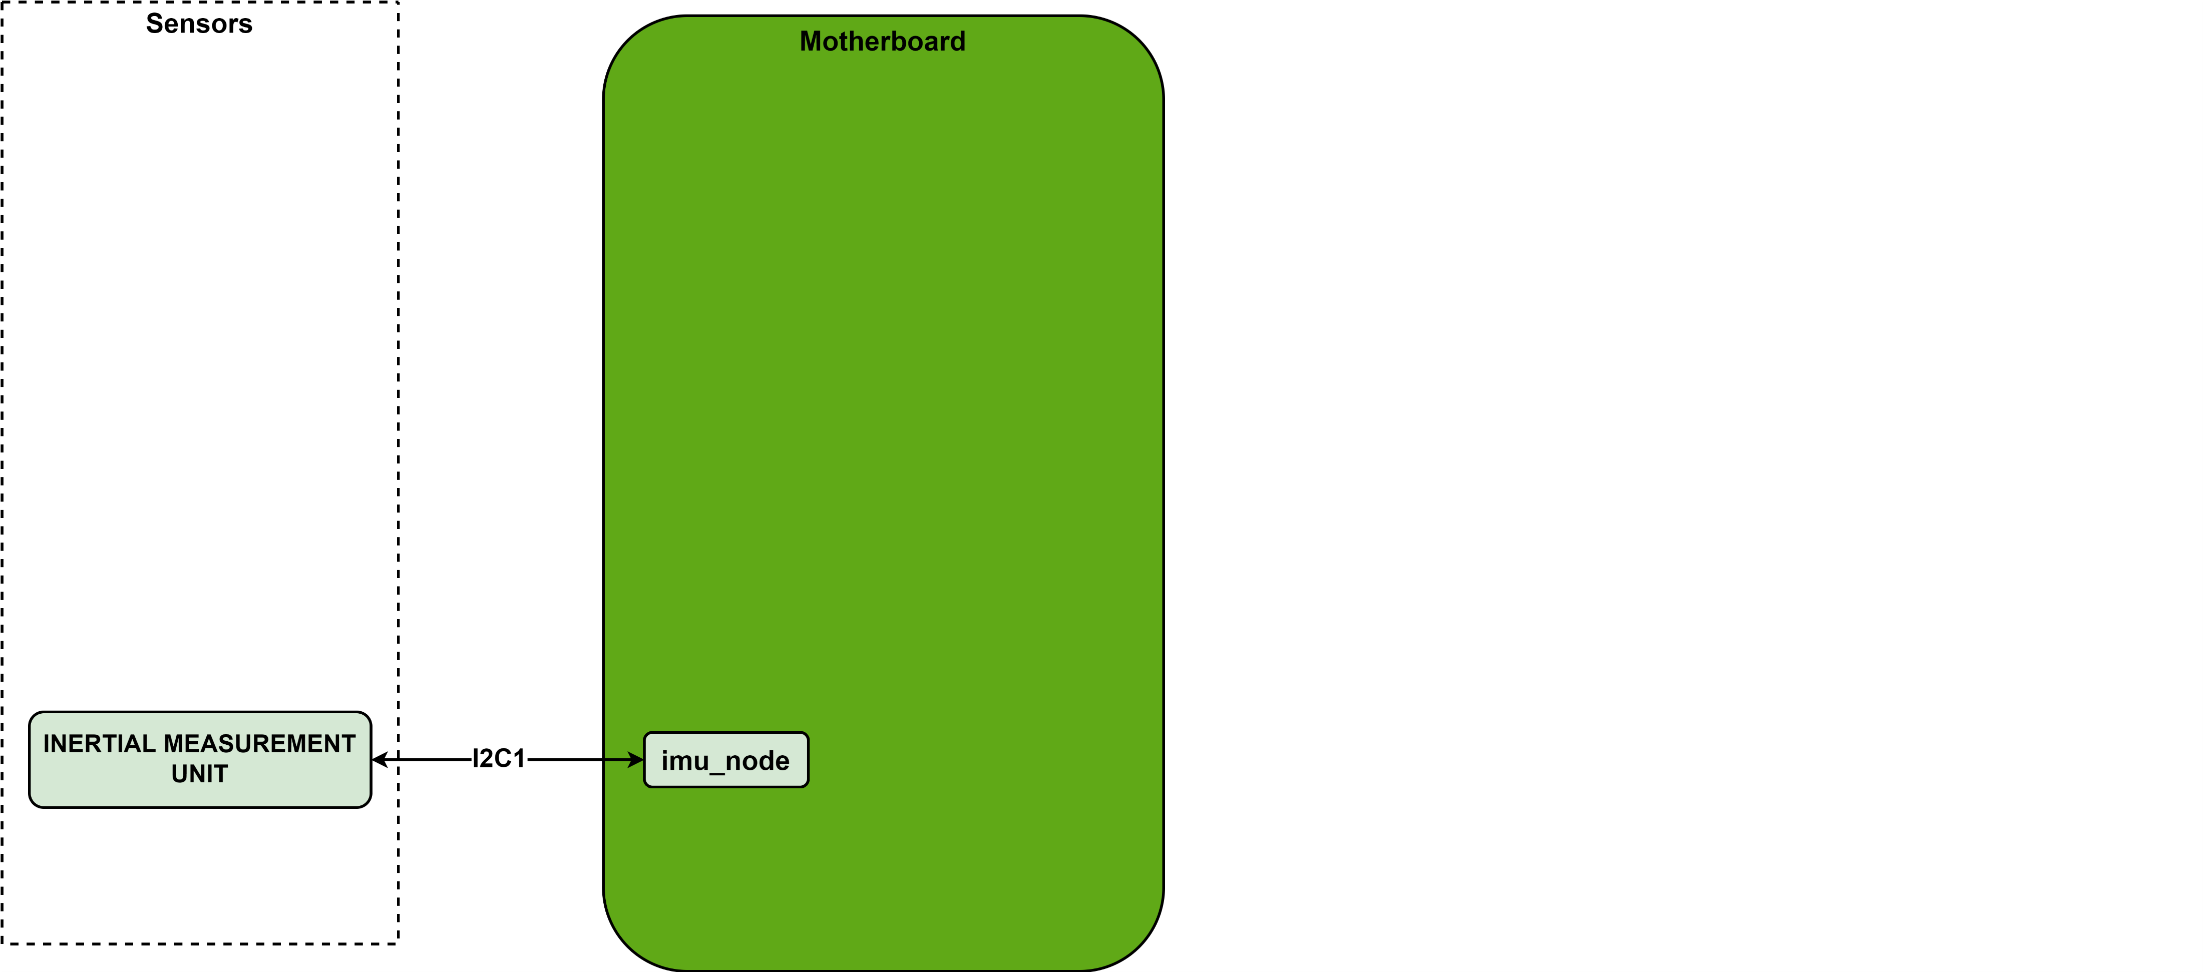
x. INERTIAL MEASUREMENT UNIT SENSOR

Slide 21
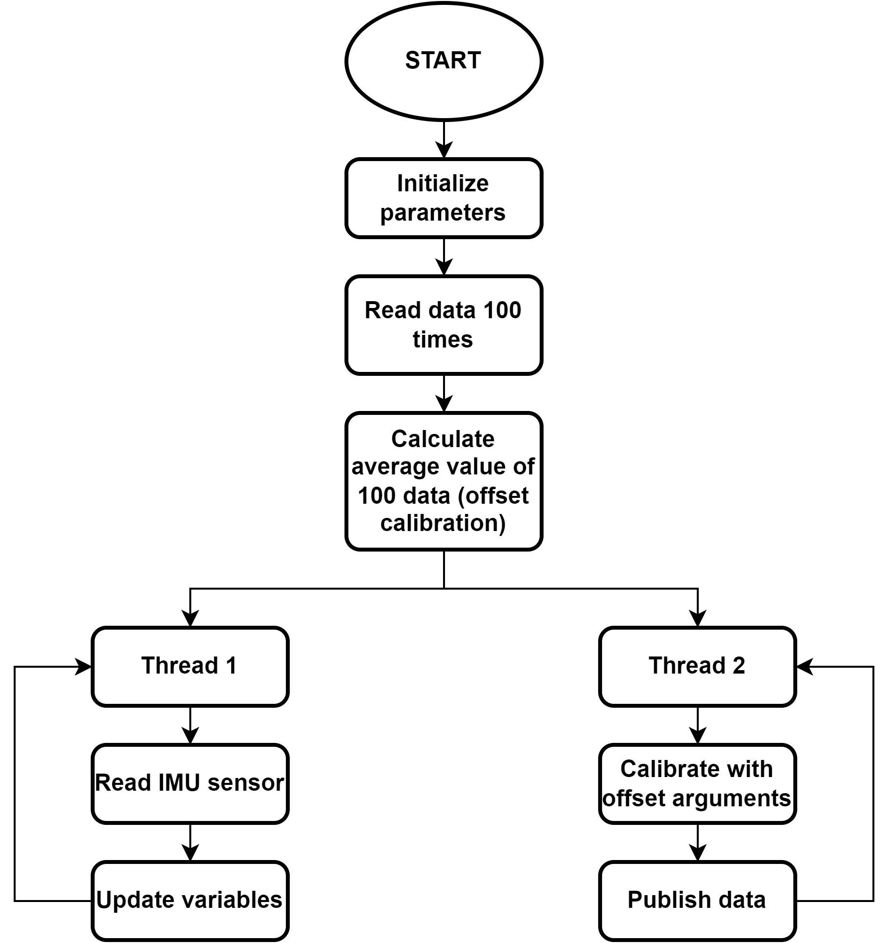
x. INERTIAL MEASUREMENT UNIT SENSOR
IMU MPU-6050 operates normally

Slide 22
x. LIDAR SENSOR

Slide 23
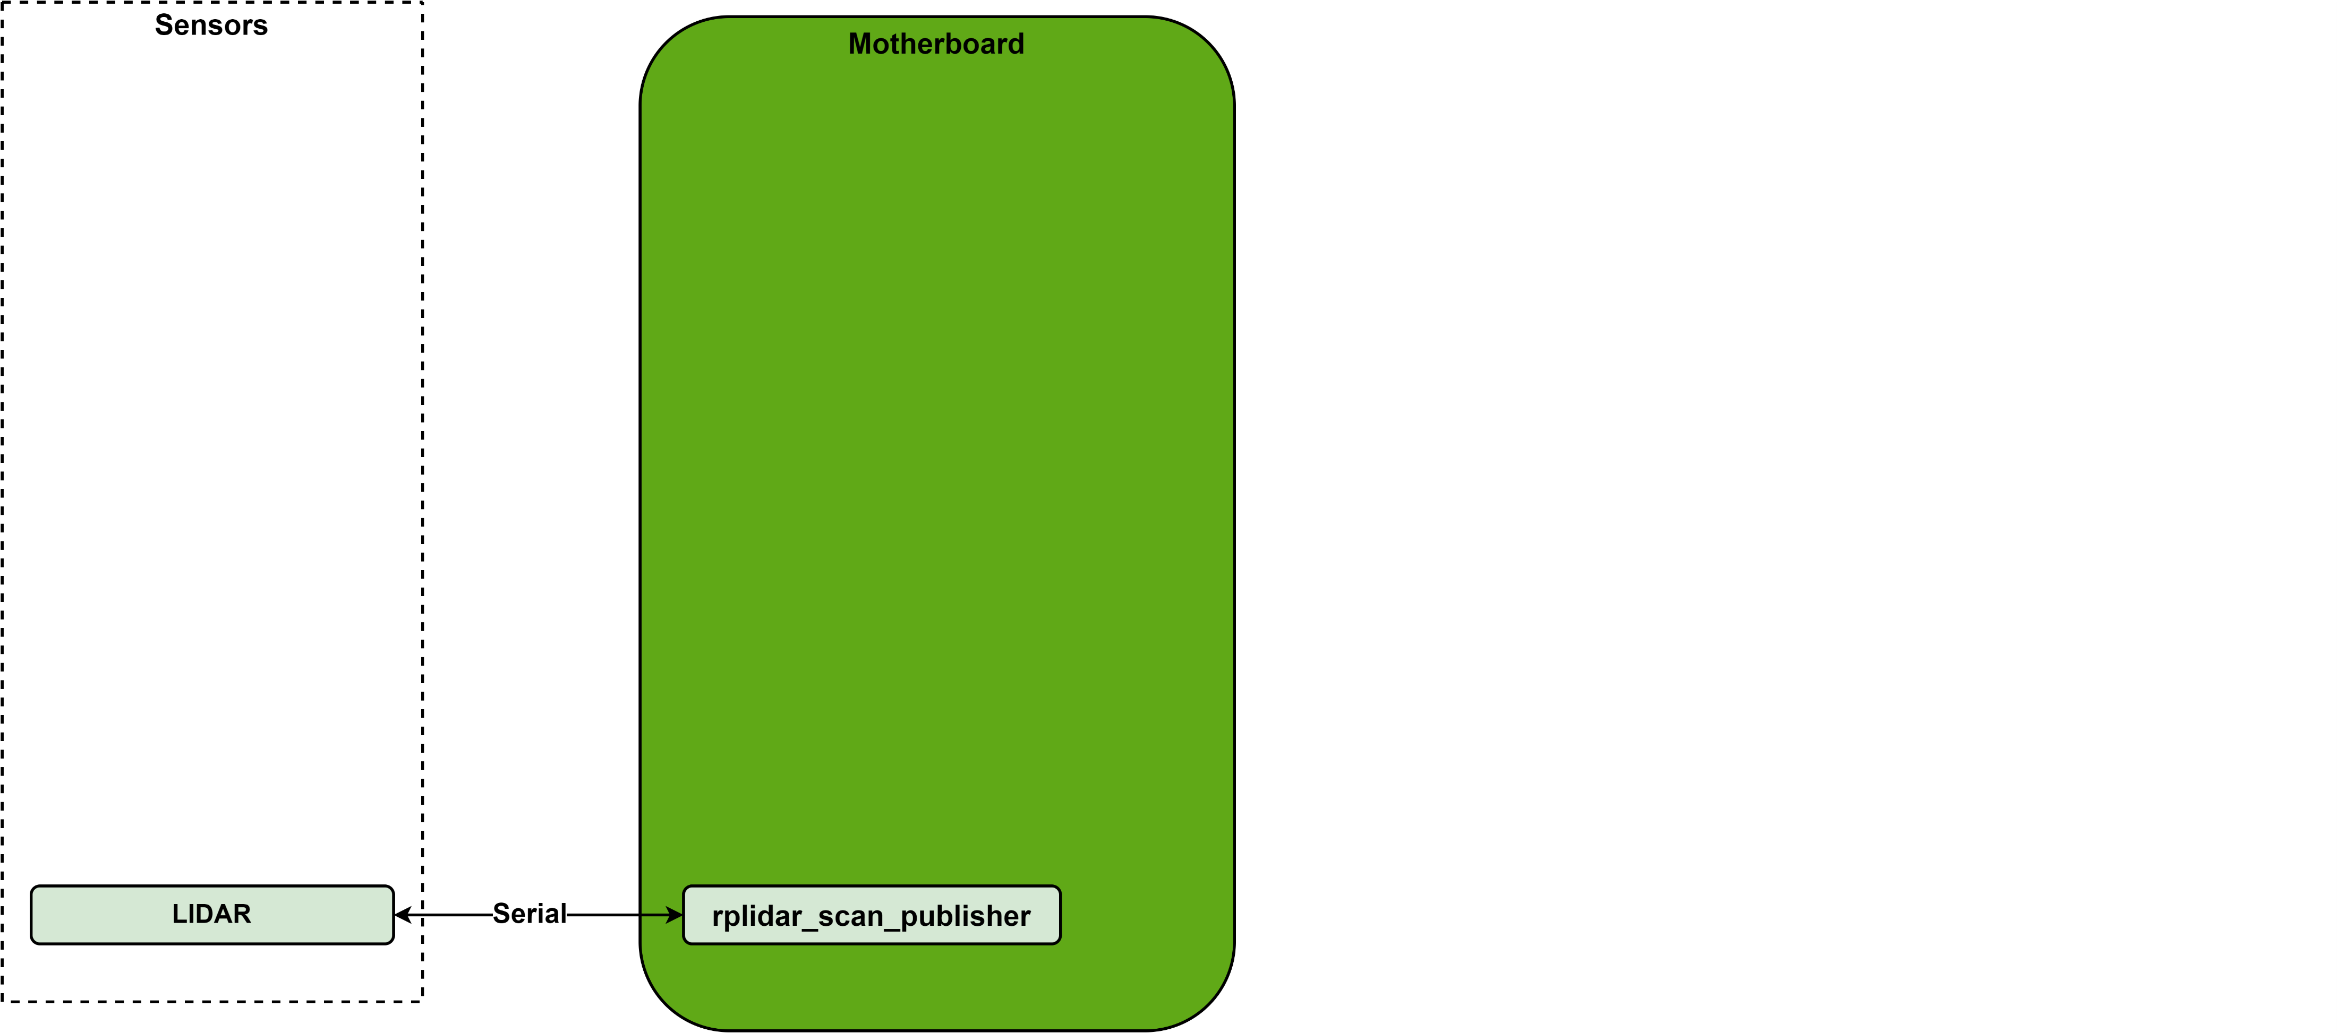
x. LIDAR SENSOR

Slide 24
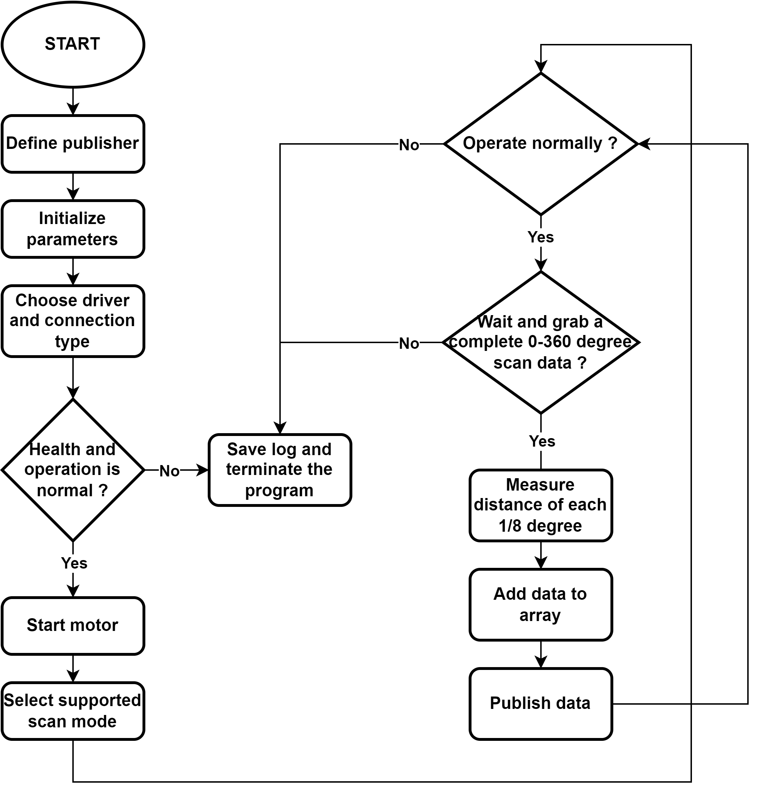
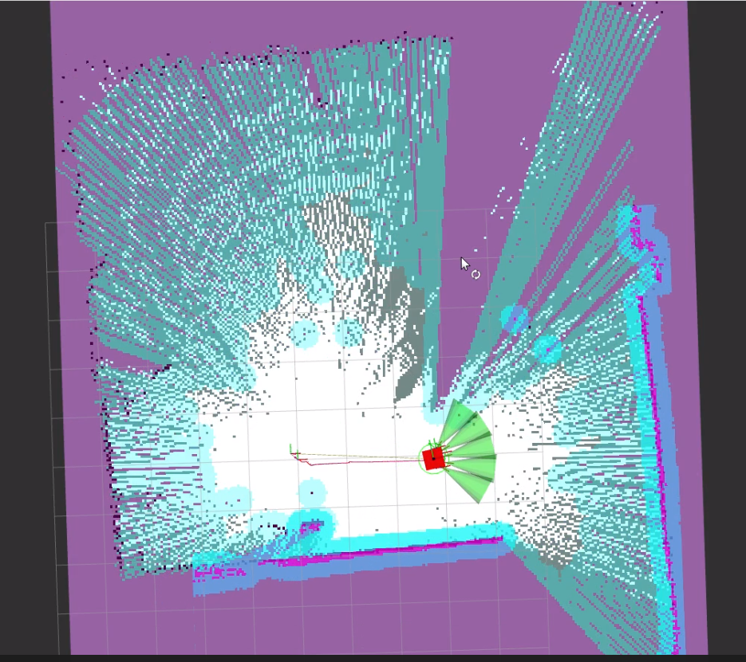
x. LIDAR SENSOR
The Obtained Environment Map from RPLIDAR A1 Scanning

Slide 25
x. INFRARED SENSOR

Slide 26
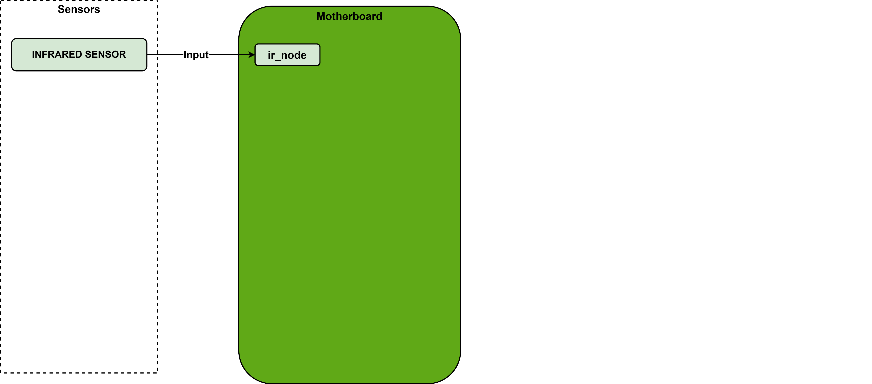
x. INFRARED SENSOR

Slide 27
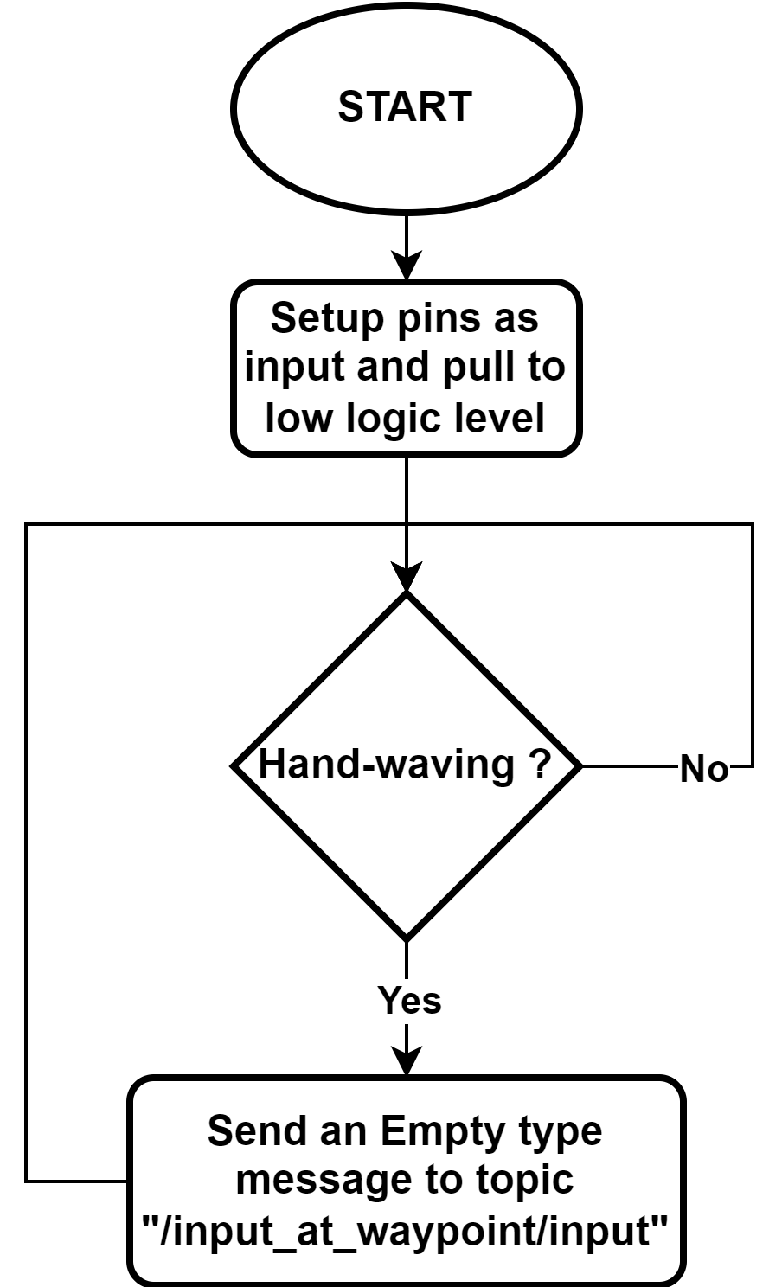
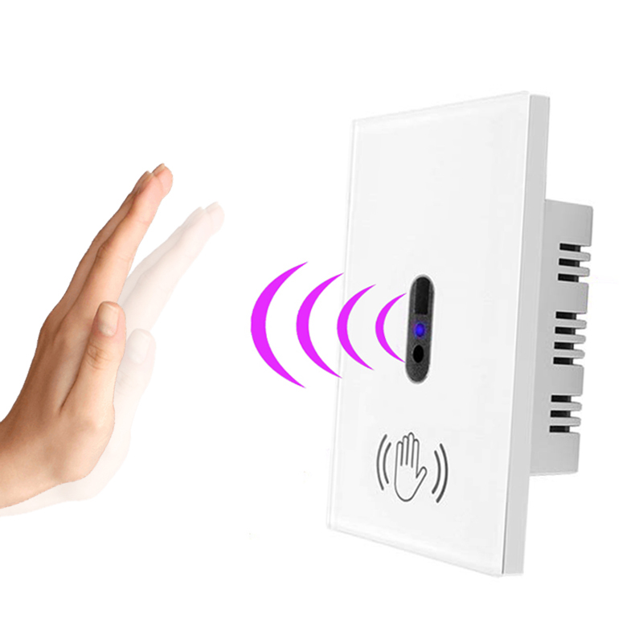
x. INFRARED SENSOR

Slide 28
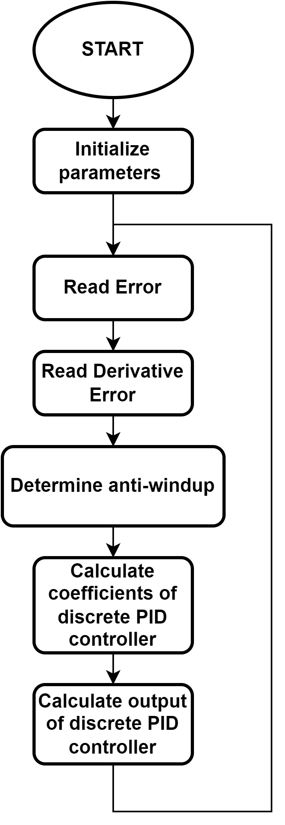
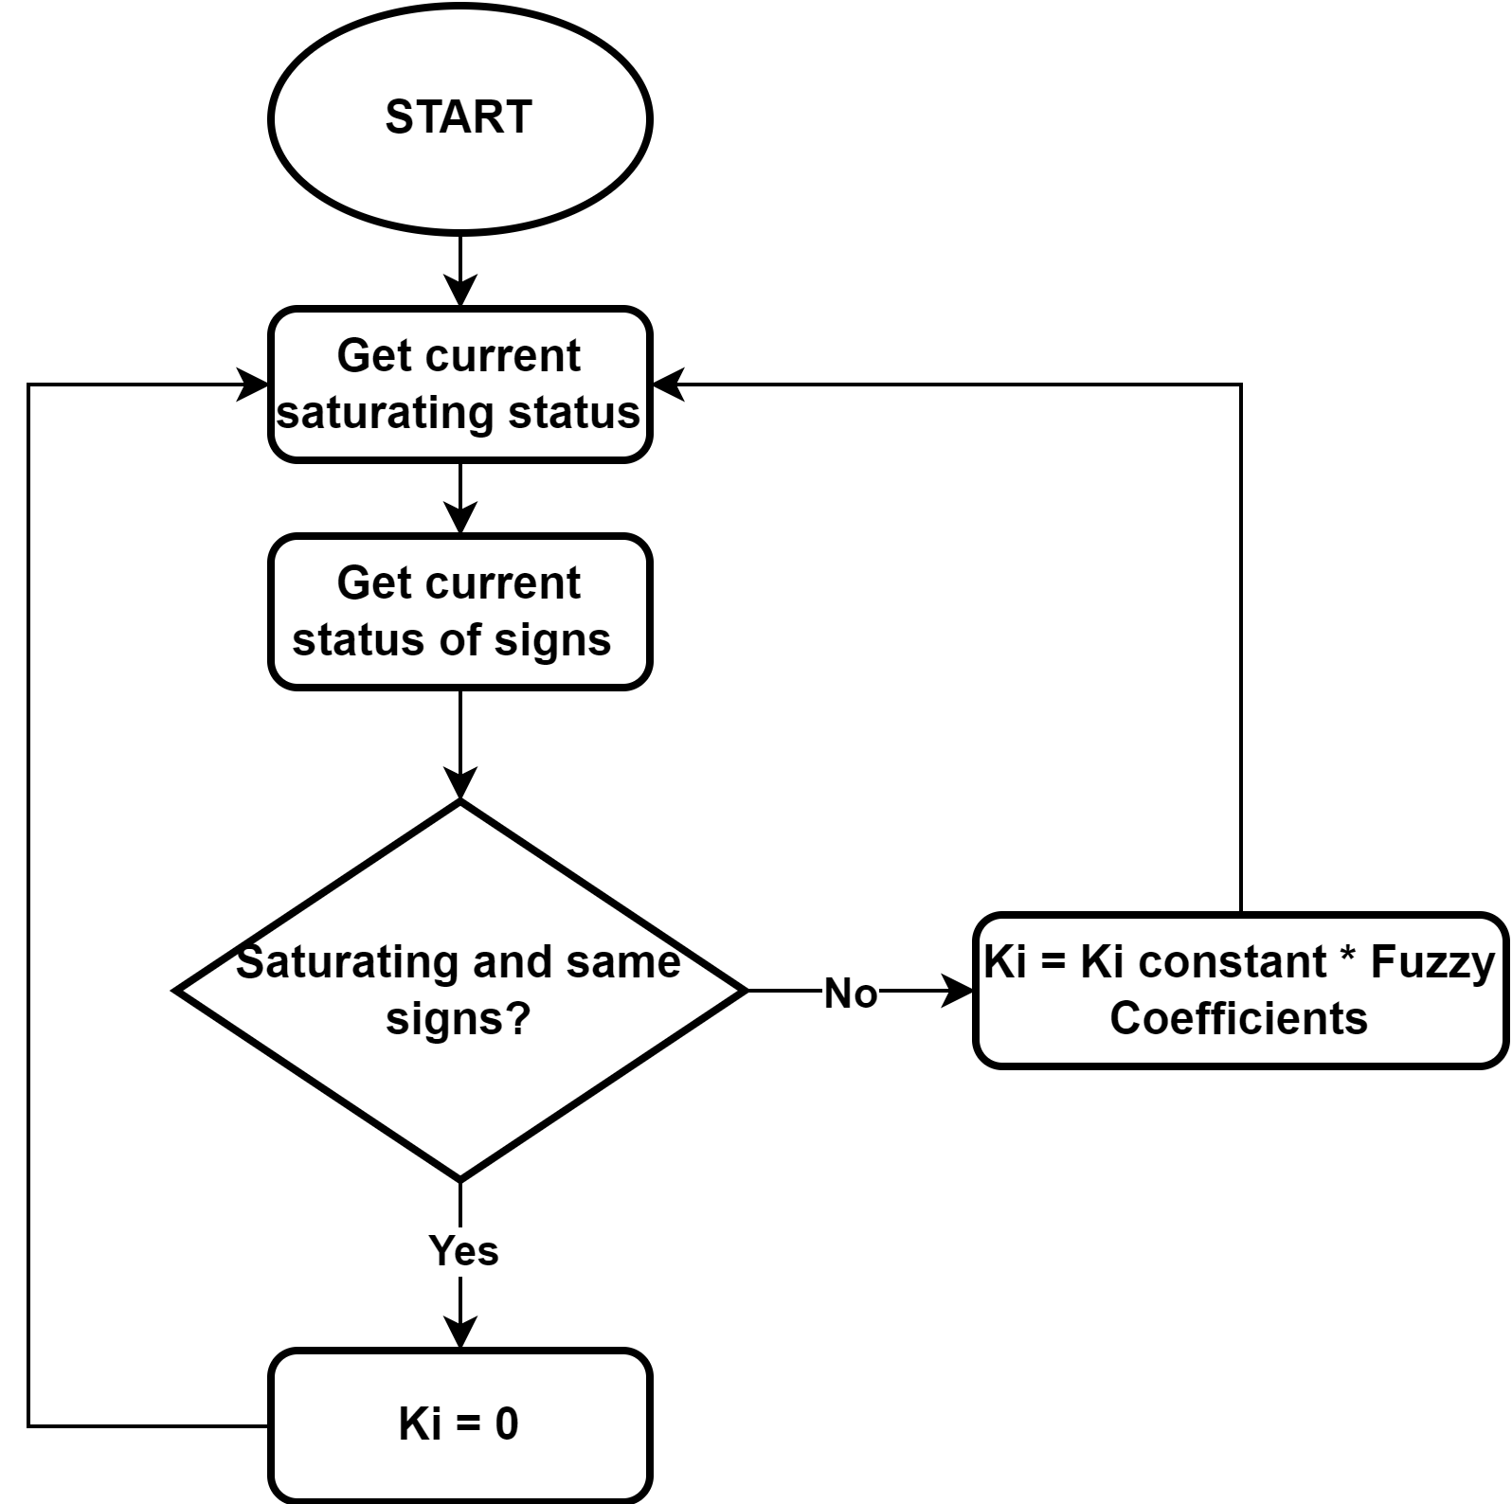
x. PID CONTROLLER FLOWCHART

Slide 29
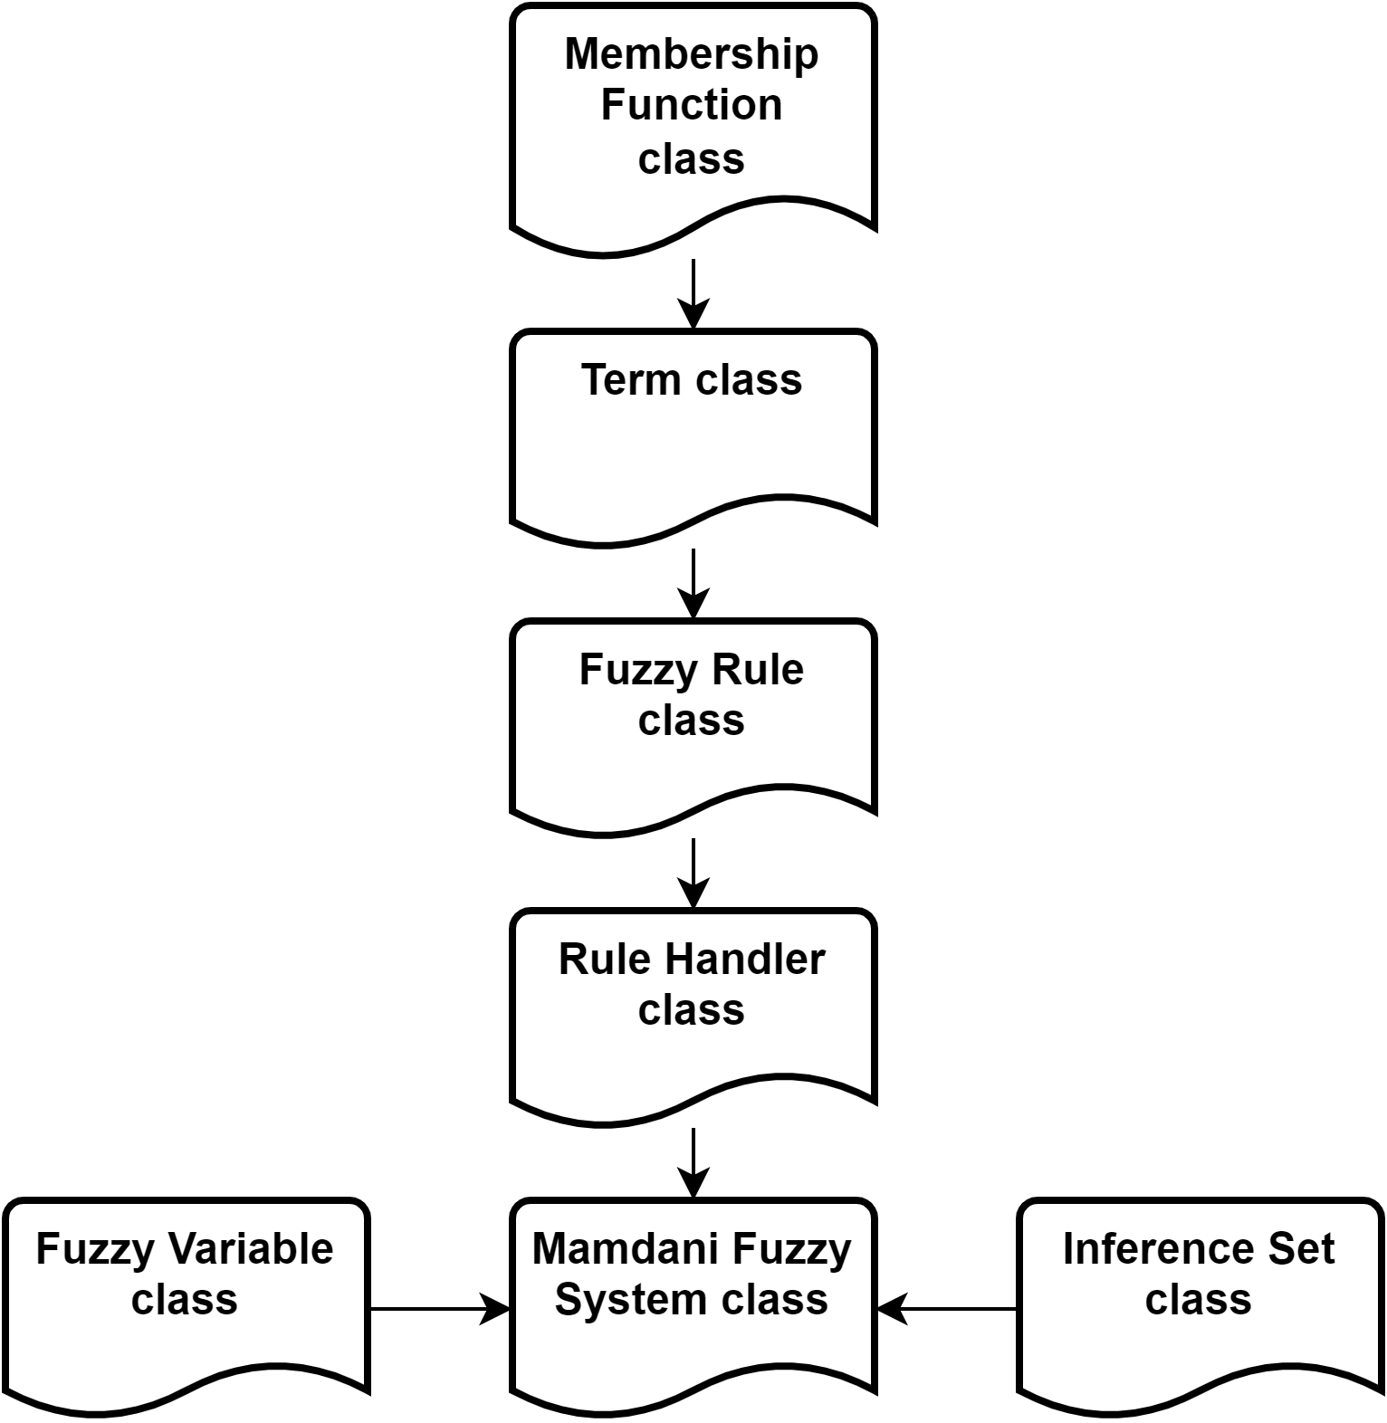
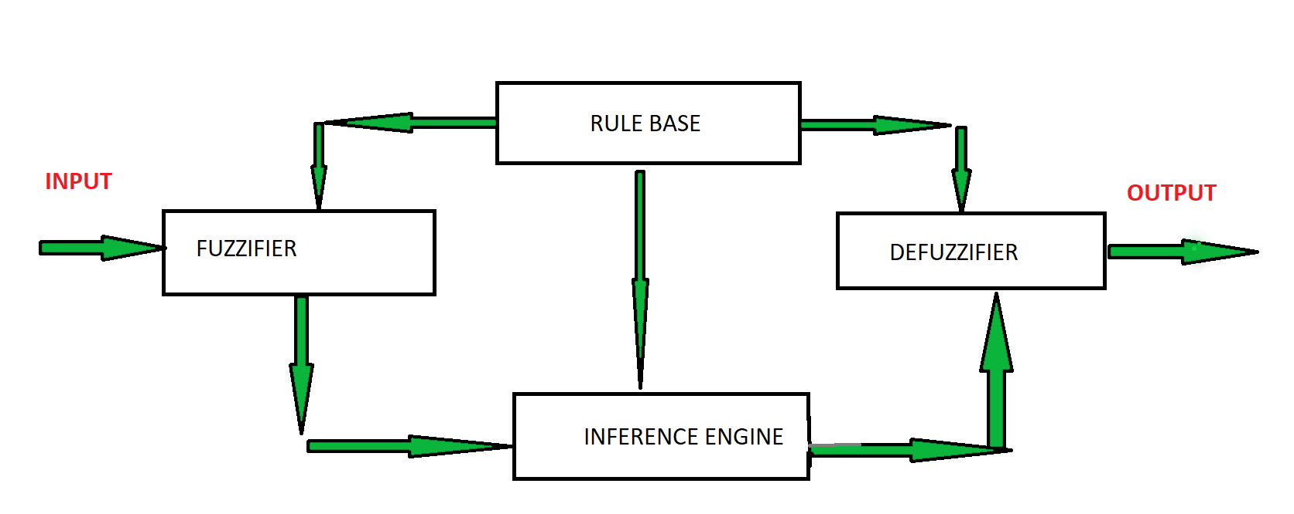
x. C++ FUZZY LOGIC LIBRARY

Slide 30
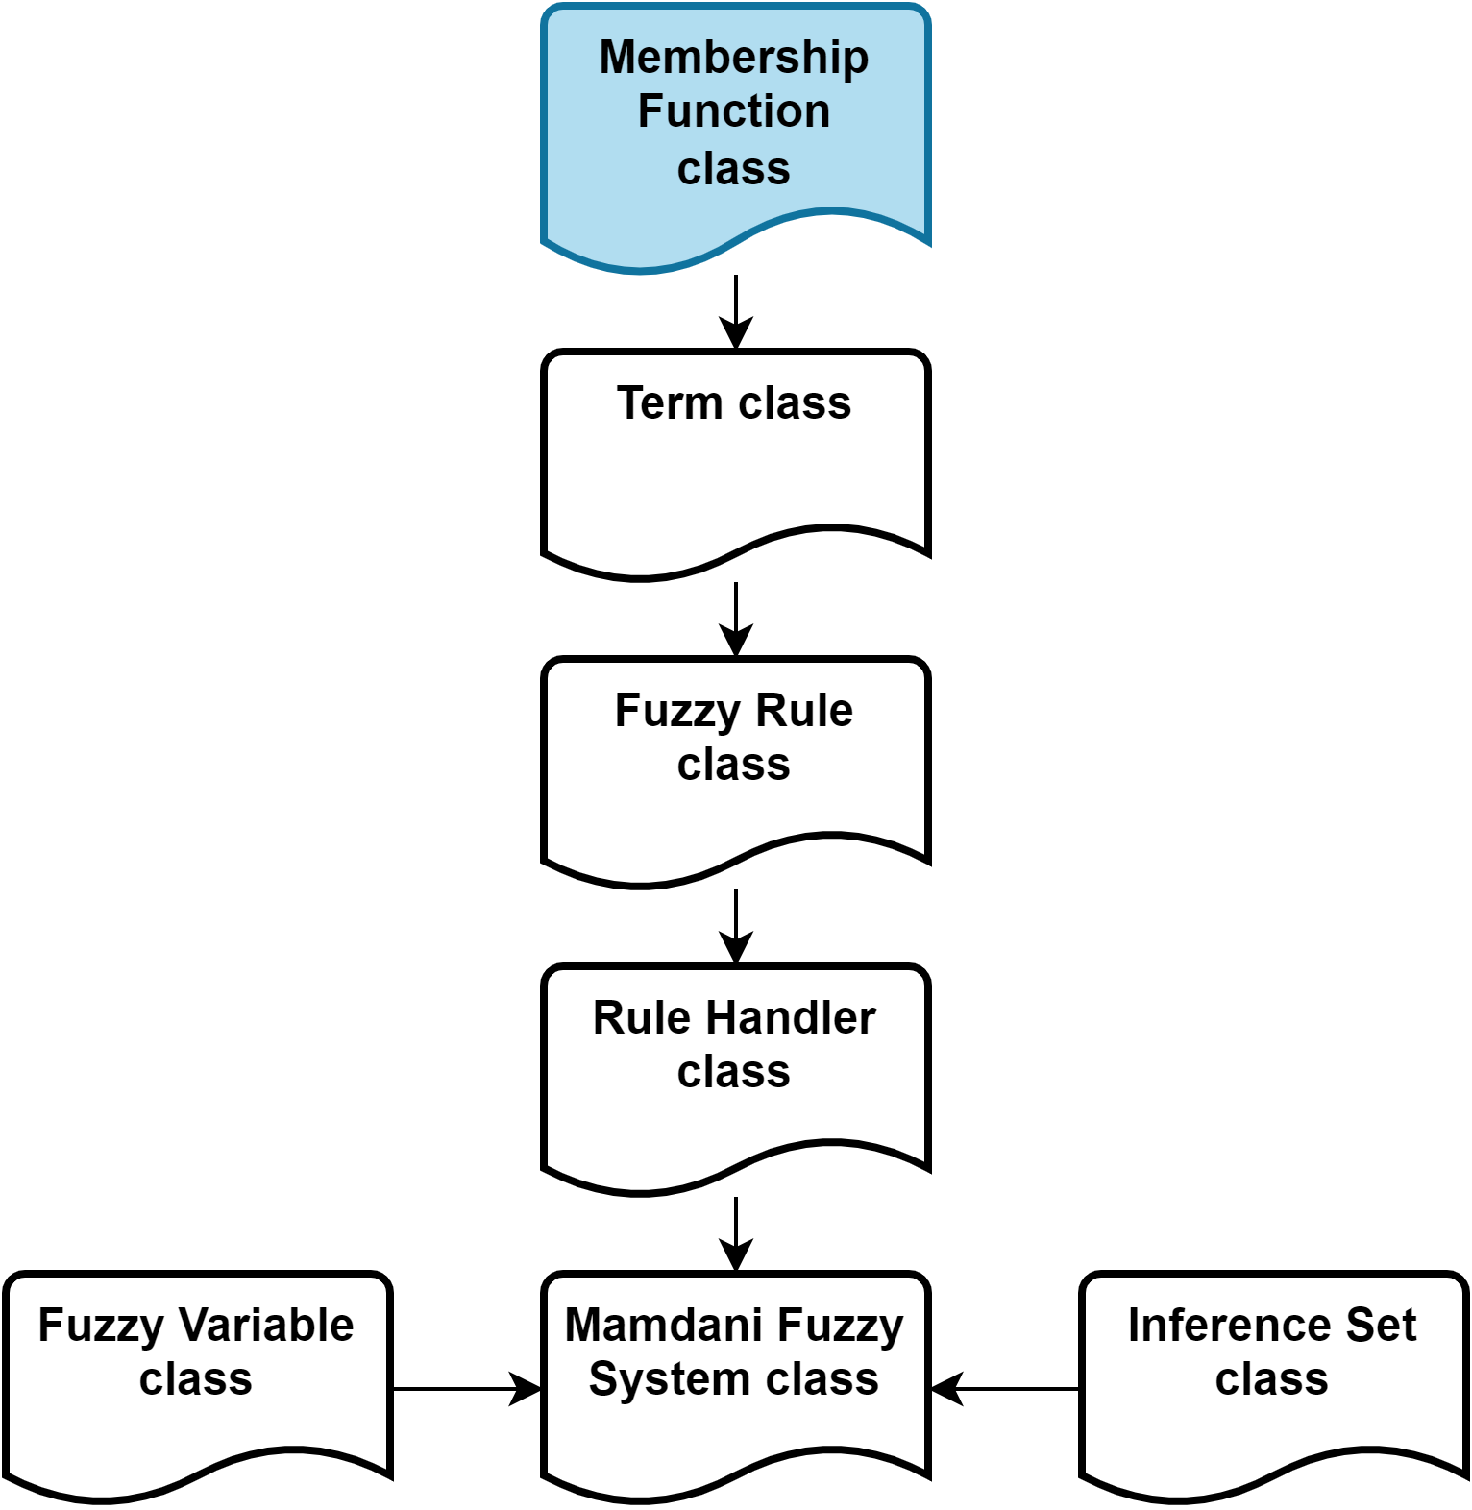
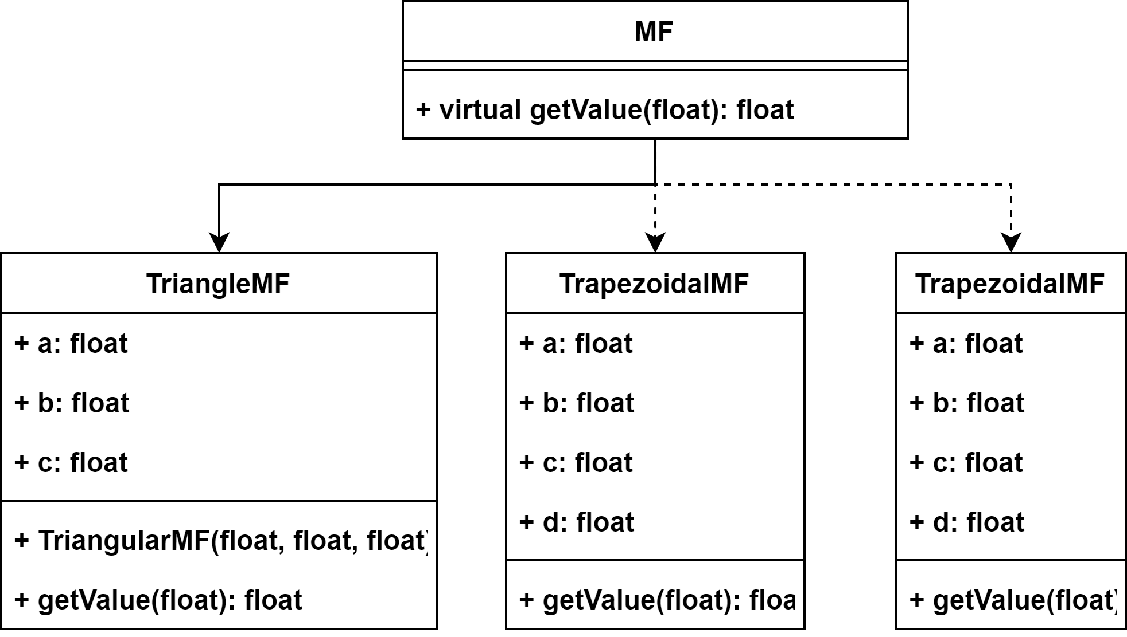
x. C++ FUZZY LOGIC LIBRARY

Slide 31
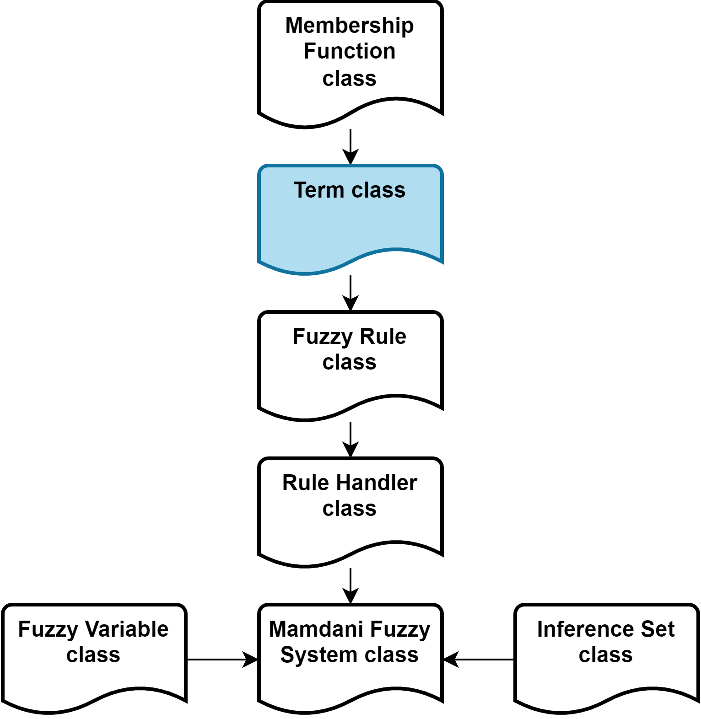
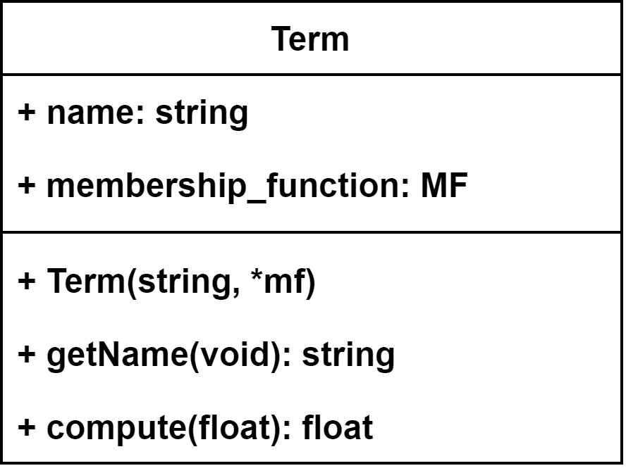
x. C++ FUZZY LOGIC LIBRARY

Slide 32
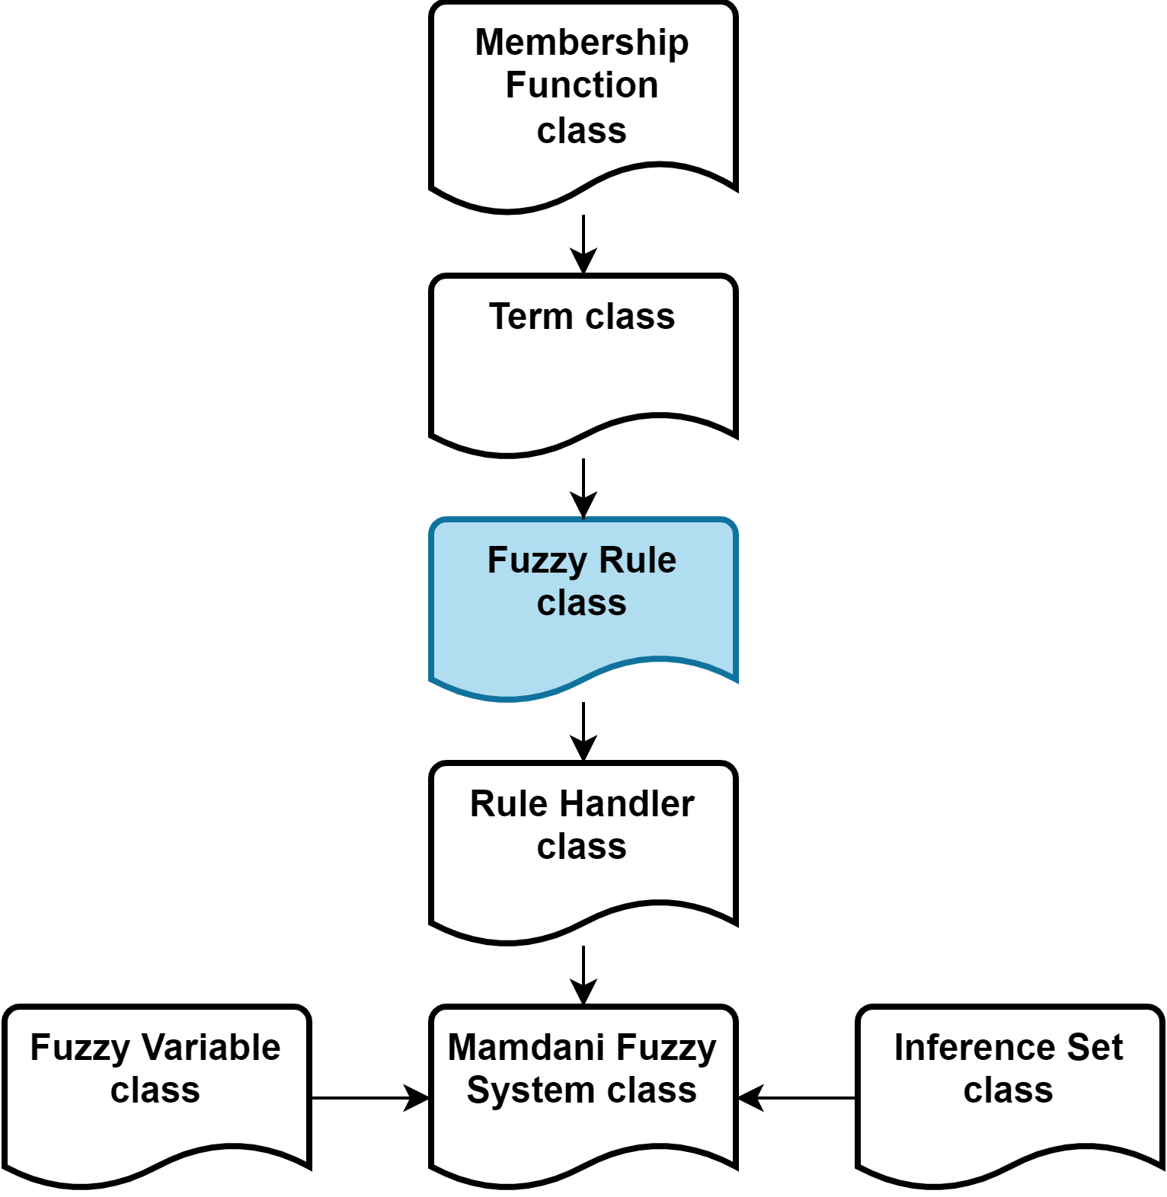
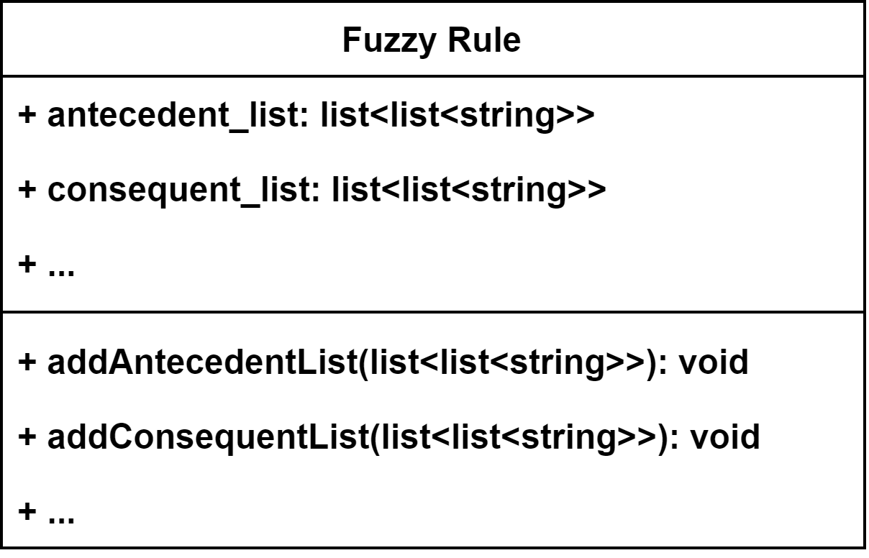
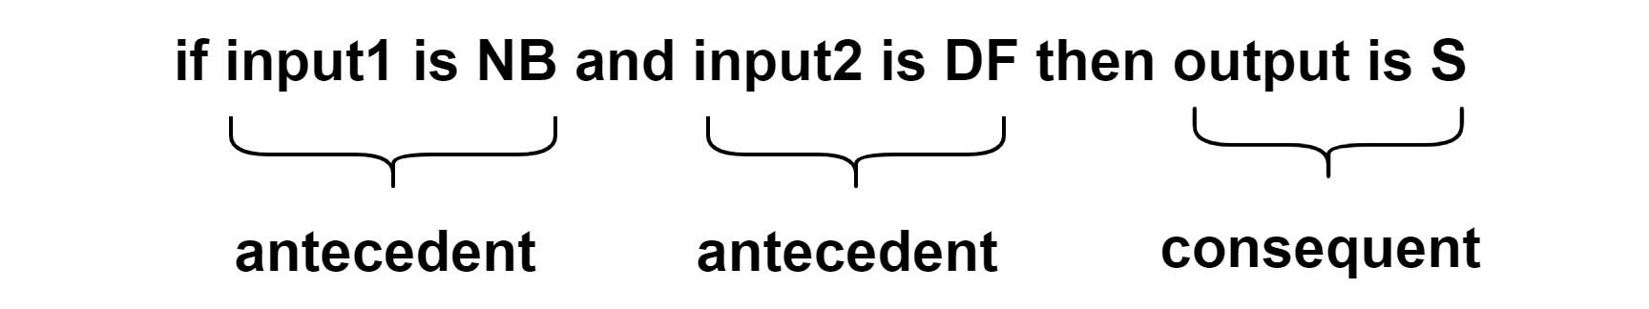
x. C++ FUZZY LOGIC LIBRARY

Slide 33
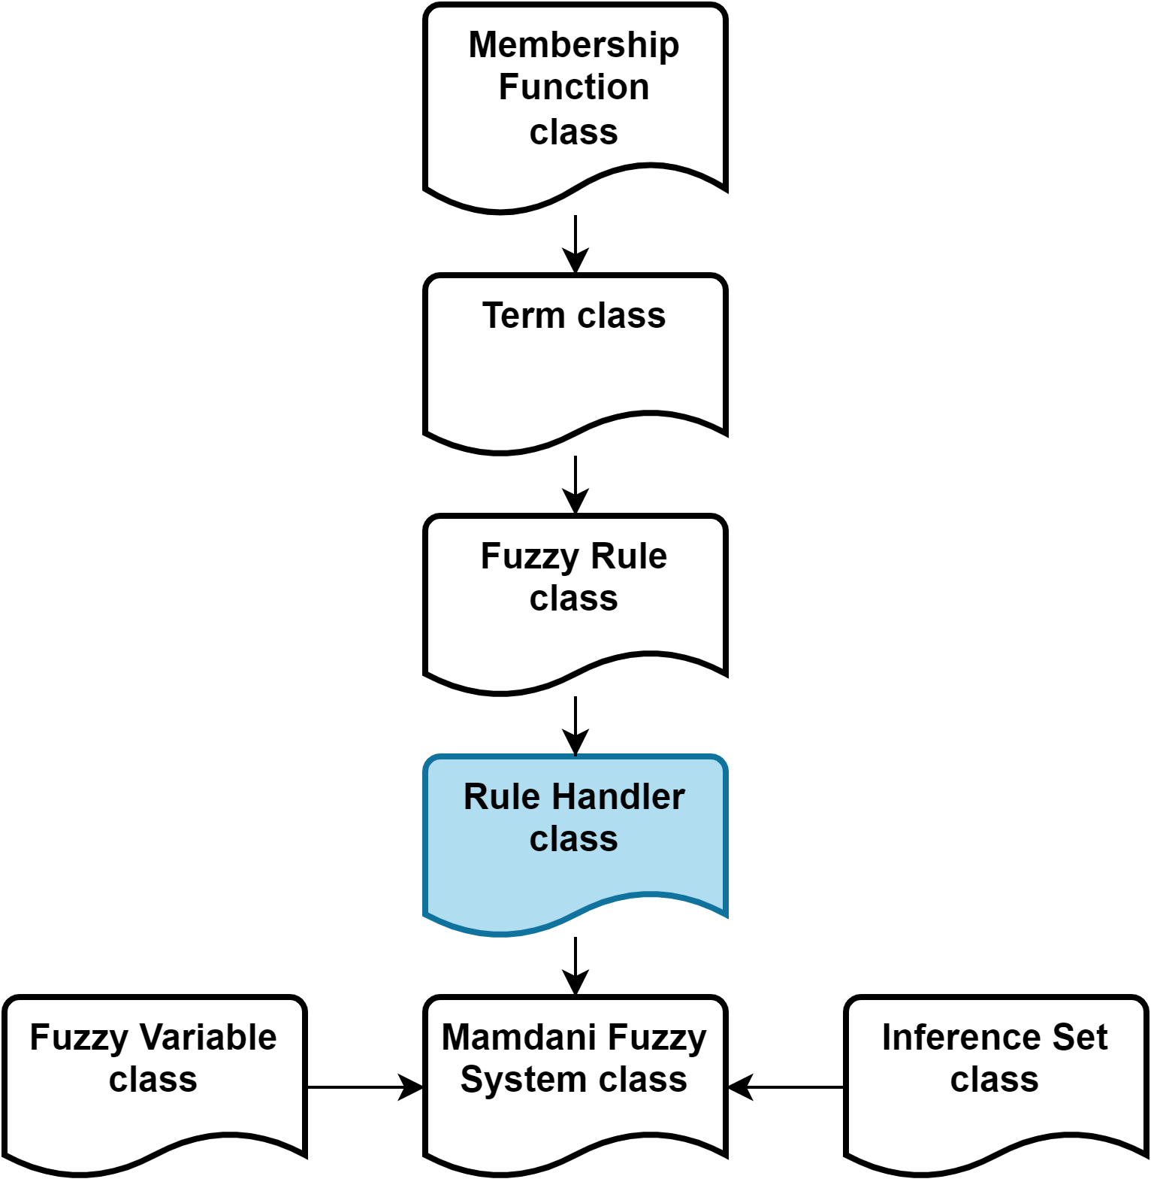
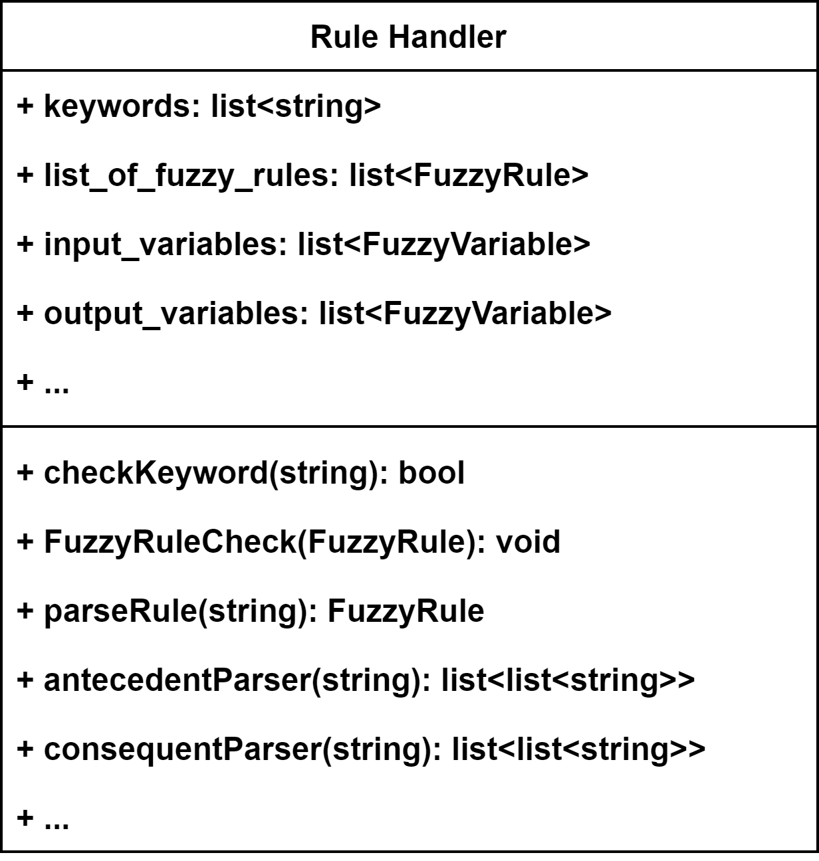
x. C++ FUZZY LOGIC LIBRARY

Slide 34
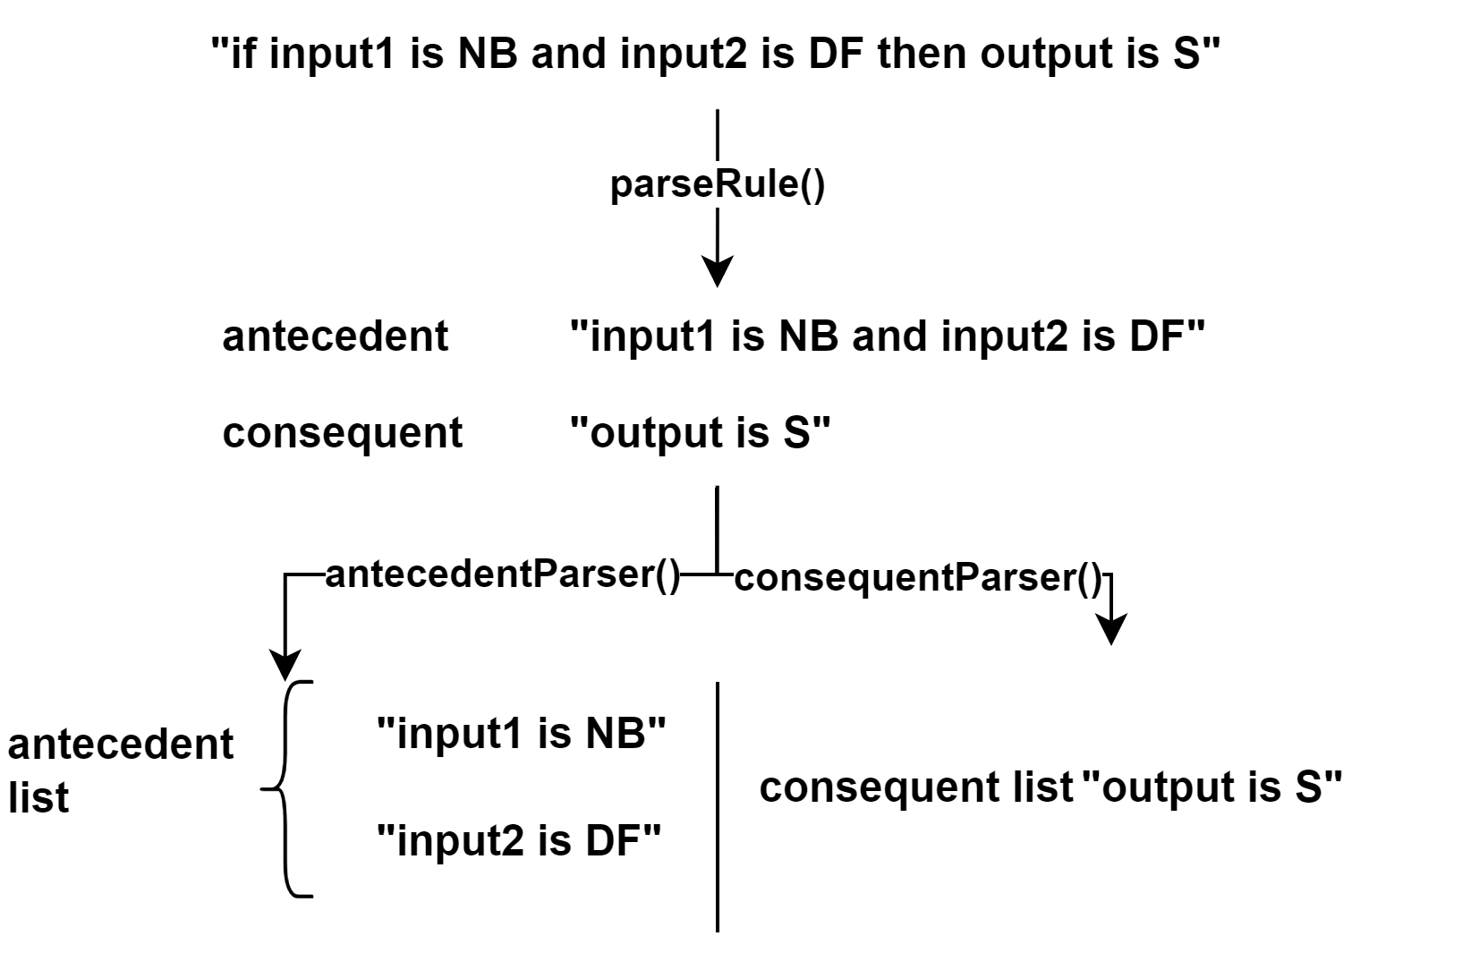
x. C++ FUZZY LOGIC LIBRARY

Slide 35
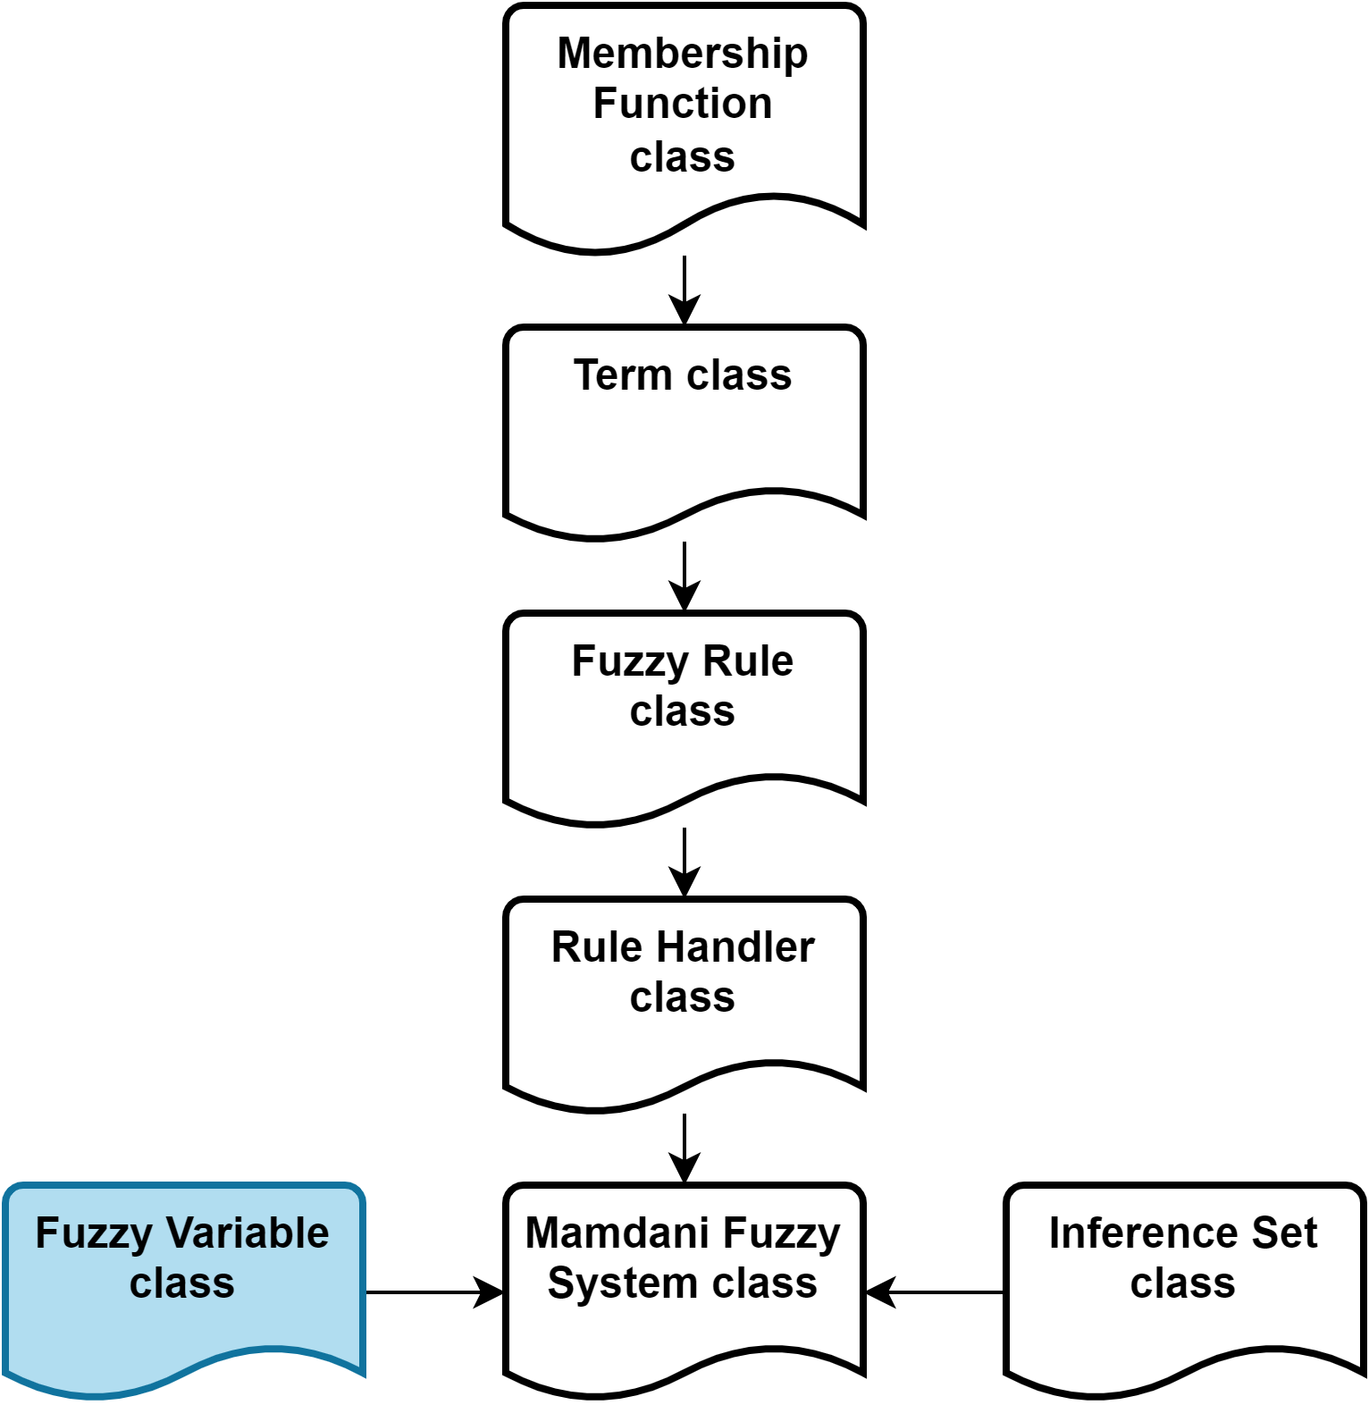
x. C++ FUZZY LOGIC LIBRARY

Slide 36
x. C++ FUZZY LOGIC LIBRARY

Slide 37
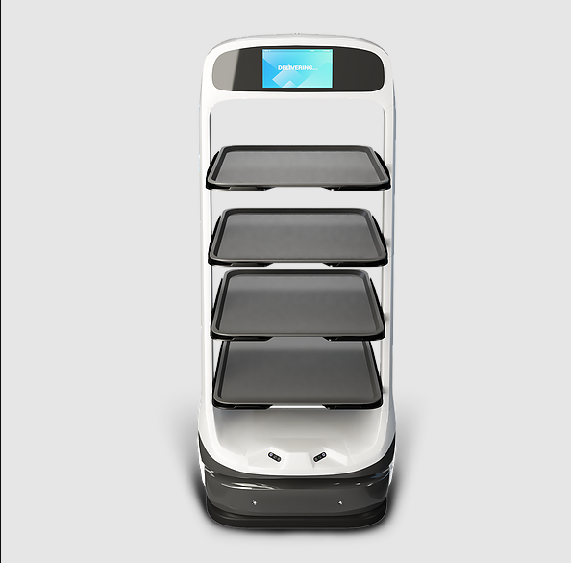
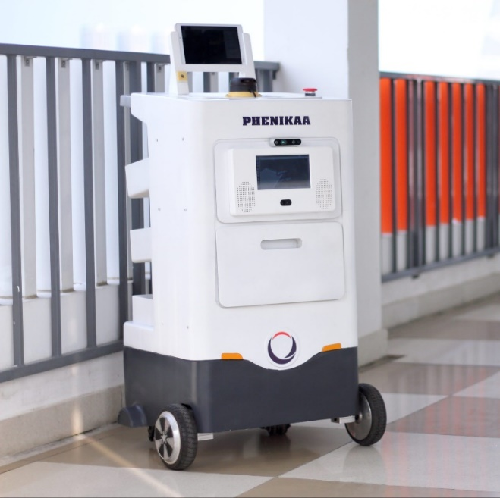
1. INTRODUCTION
Matradee Robot
Phenikaa-X delivery Robot

Slide 38
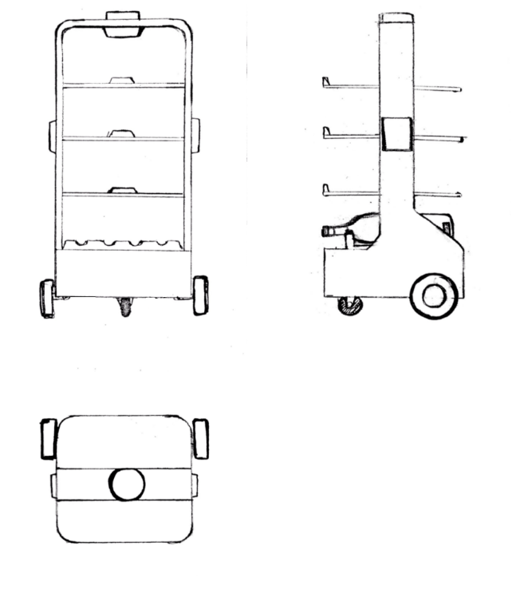
2. DESIGN IDEA
Design purpose:
+ Robot can self-navigate to the desired goal and avoid obstacles.
+ Robot can interact with customer via screen and speaker.
Specification:
+ Sensor: LiDAR, Ultrasonic sensor, IMU
+ Navigation method: SLAM
+ Body weight: 7 kg
+ Maximum load weight: 15 kg
+ Speed: 0.5 m/s
+ Power: 54 W
2D design

Slide 39
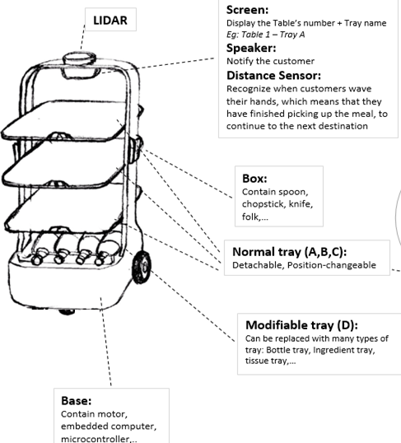
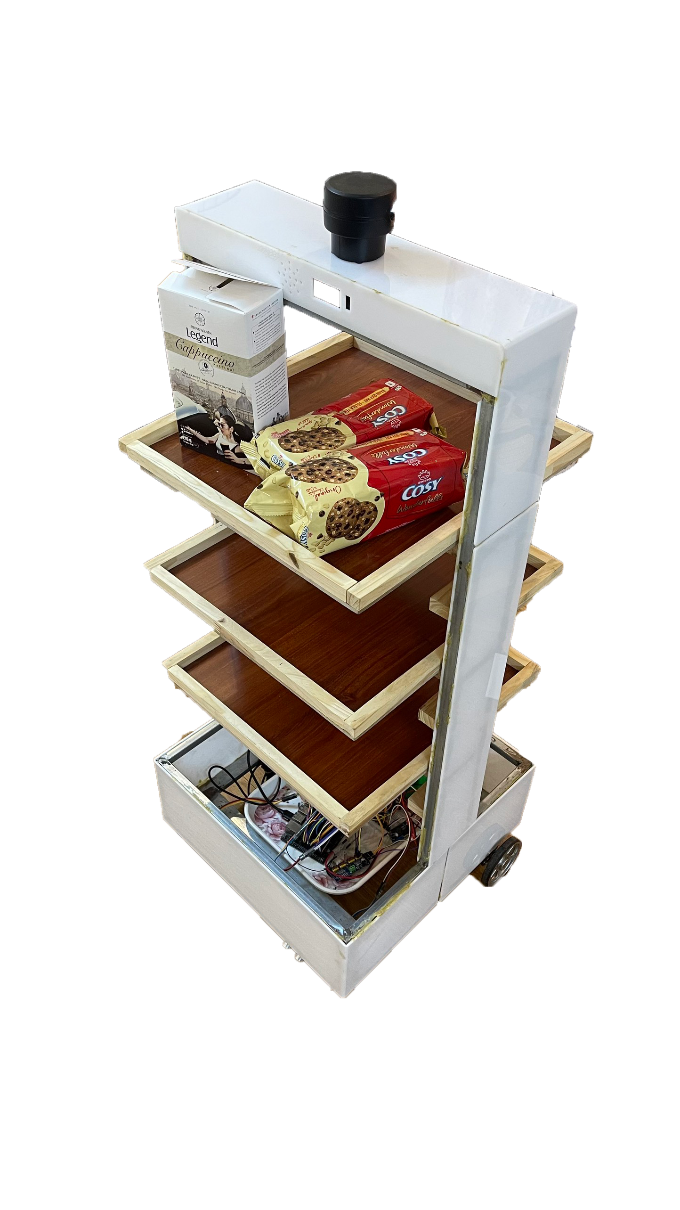
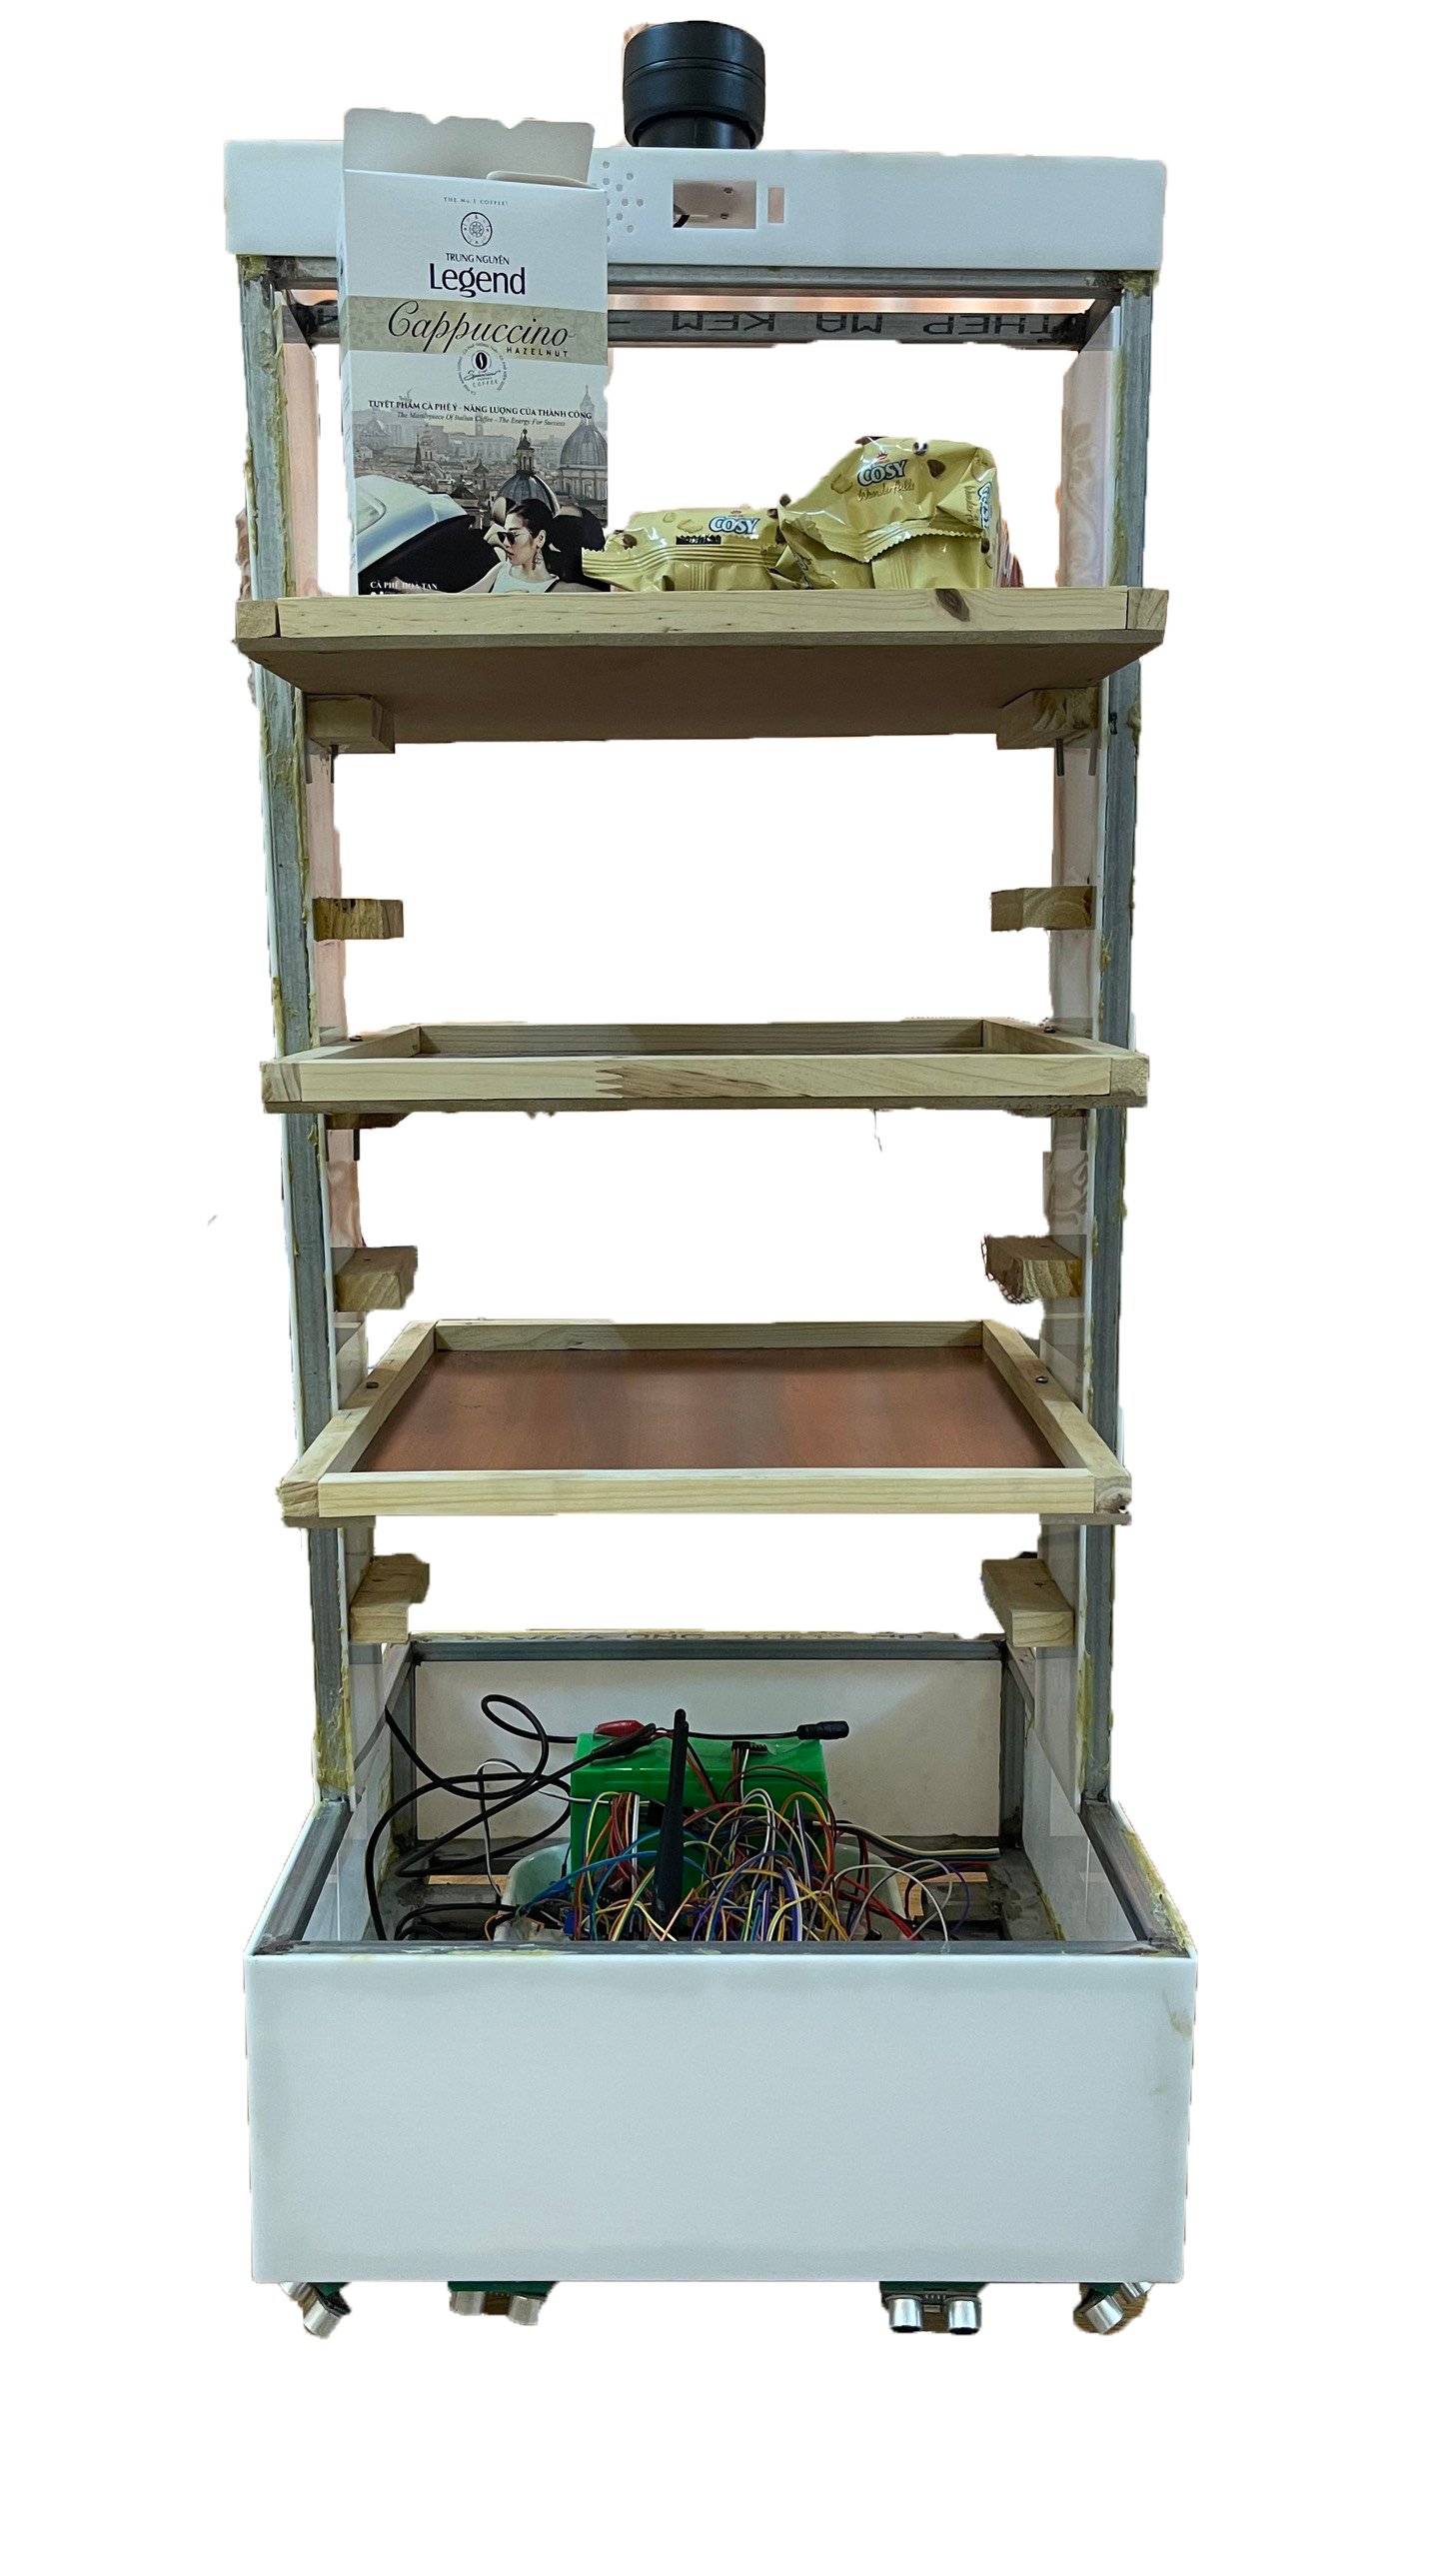
2. DESIGN IDEA

Slide 40
THANK YOU !

